Slide 1
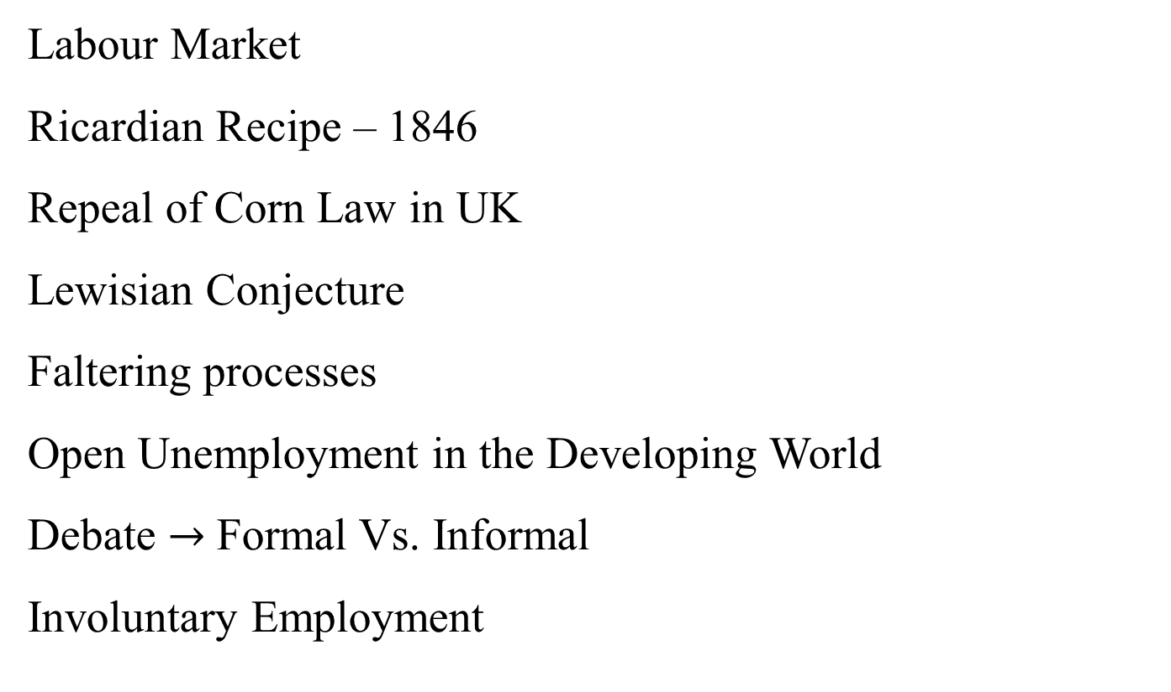
Labour Market Issues
Labour Market
Ricardian Recipe – 1846
Repeal of Corn Law in UK
Lewisian Conjecture
Faltering processes
Open Unemployment in the Developing World
Debate $→$ Formal Vs. Informal
Involuntary Employment

Slide 2
Rural – Urban Migration
Harris and Todaro (1970)

Slide 3
$\overline{W}\frac{L_{M}}{L−L_{R}}=W, \overline{L}>L_{M}+L_{R}$ … (5.1)
HT Migration Equilibrium
Suppose Govt. gives Employment Subsidy s.
R
$$\overline{w}$$
w
w
u
$$L_{M}$$
$$L_{u}$$
$$L_{R}$$
Fig. 5.1

Slide 4

$L_{M}+L_{R}=\frac{w(L_{R})}{\overline{w}}\overline{L}+L_{R}\left(1−\frac{w\left(L_{R}\right)}{\overline{w}}\right)$ … (5.2)
$$L_{M}+L_{R}$$
LHS
(1)
(2)
$$L_{R}$$
Fig. 5.3
If w does not change much, a fall in rural emp. means $L_{M}+L_{R} ↓$ i.e.Unemployment goes up with Wage Subsidy, paradox.

Slide 5
$\frac{w}{\overline{w}}=\frac{L_{M}}{L_{M}+L_{u}}=\frac{1}{1+\frac{L_{u}}{L_{M}}}$ … (5.3)
If w does not change $\frac{L_{u}}{L_{M}}$ does not change, if $L_{M}↑$, $L_{u} ↑$
Employment subsidy $↑$ unemployment.Corden and Findlay (1974)
Problems of HT model
Hiring and Firing process
How they sustain while unemployed
Open Unemployment less among the Poor

Slide 6
Formal Vs. Informal Employment
Large chunk of workforce is absorbed in the unorganized or informal (unregistered, undocumented, extra-legal) sector.
Why? To avoid regulations , state may encourage – political economic reasons

Slide 7
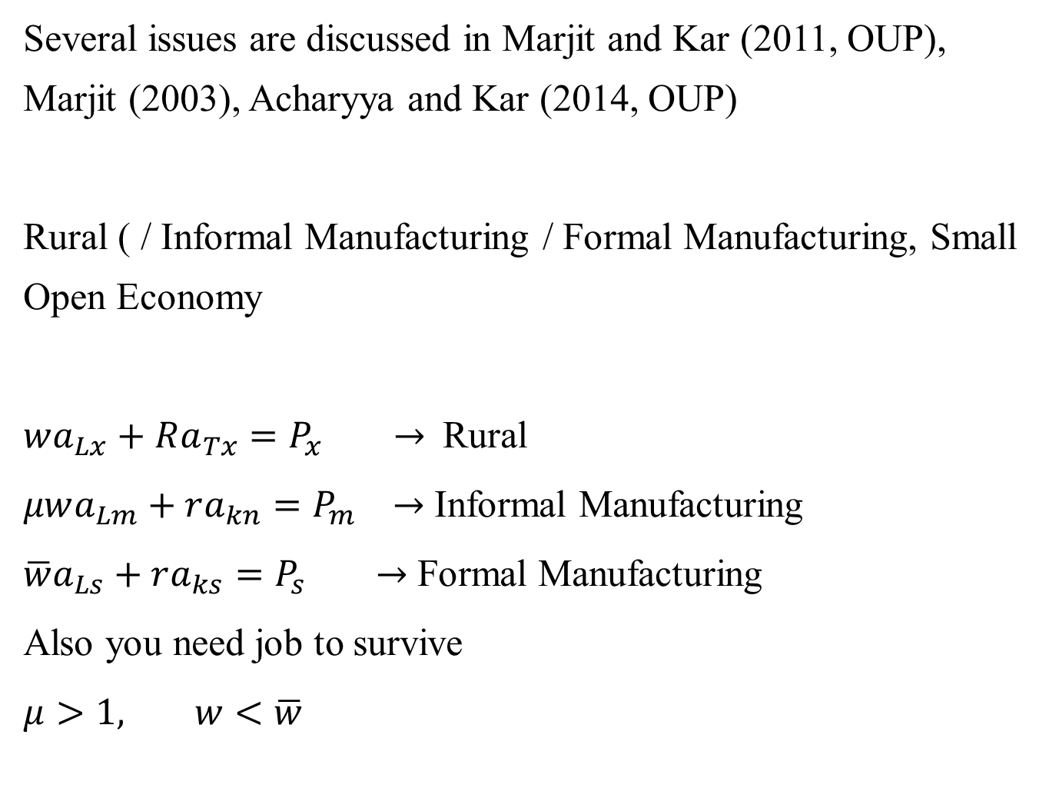
Several issues are discussed in Marjit and Kar (2011, OUP), Marjit (2003), Acharyya and Kar (2014, OUP)
Rural ( / Informal Manufacturing / Formal Manufacturing, Small Open Economy
$wa_{Lx}+Ra_{Tx}=P_{x} →$Rural
$μwa_{Lm}+ra_{kn}=P_{m} →$ Informal Manufacturing
$\overline{w}a_{Ls}+ra_{ks}=P_{s} →$ Formal Manufacturing
Also you need job to survive
$μ>1, w<\overline{w}$

Slide 8
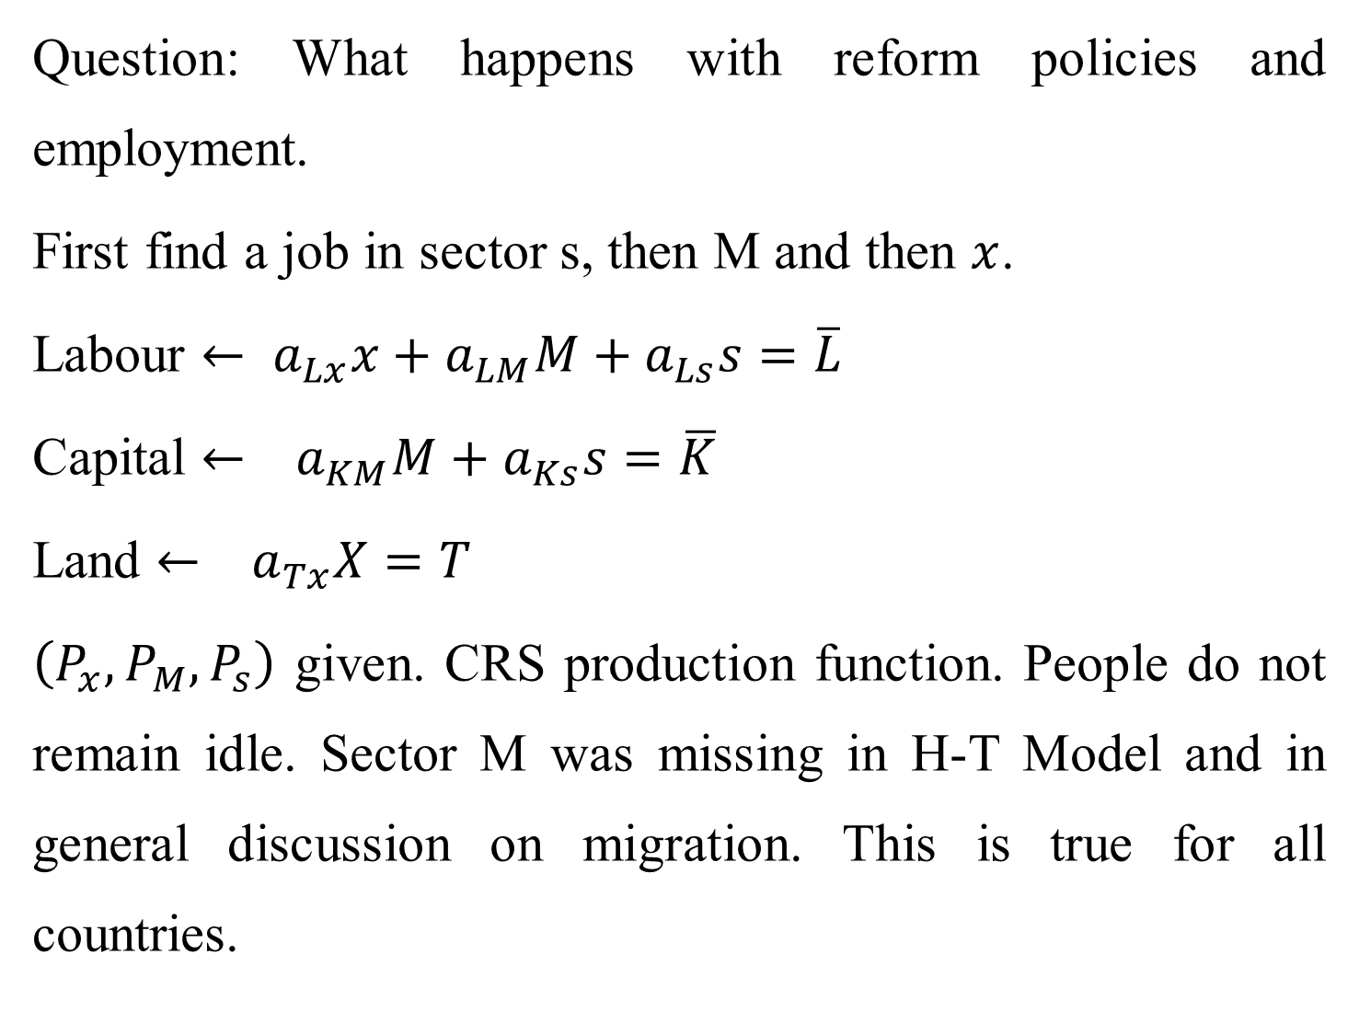
Question: What happens with reform policies and employment.
First find a job in sector s, then M and then $x$.
Labour $←$ $a_{Lx}x+a_{LM}M+a_{Ls}s=\overline{L}$
Capital $← a_{KM}M+a_{Ks}s=\overline{K}$
Land $← a_{Tx}X=T$
$\left(P_{x},P_{M},P_{s}\right)$ given. CRS production function. People do not remain idle. Sector M was missing in H-T Model and in general discussion on migration. This is true for all countries.

Slide 9
Several interesting policy outcomes are possible.
If there is an employment subsidy in S, rural sector might expand in a way there is reverse migration.
If there is more competition such that Price of S falls, w goes up and rural sector contracts.
For more details Marjit (2003) and Marjit and Kar (2011)

Slide 10

Efficiency Wage
Worker’s productivity depends on
$X=f\left(nh\left(w\right)\right) f^{′}>0, f^{′′}<0$
$$h=h(w)$$
$$w$$
$$u^{∗}$$
Fig. 5.3
Max $L=f\left(nh\left(w\right)\right)−nw$
$f^{′}.h\left(w\right)=w$
$f^{′}.h^{′}\left(w\right)=1$
Or, $\frac{w}{h(w)}=\frac{1}{h^{′}(w)}$ $h^{′}\left(w\right)=\frac{h(w)}{w}$

Slide 11

$\frac{w}{h(w)}→$ Efficiency Wage
$$w$$
$$N^{s}$$
A
B
$$w^{∗}$$
$$N^{d}$$
$$n$$
Fig. - 5.4
AB – Unemployment
Stiglitz (1976)
Firms do not want to reduce wage because productivity will fall.

Slide 12
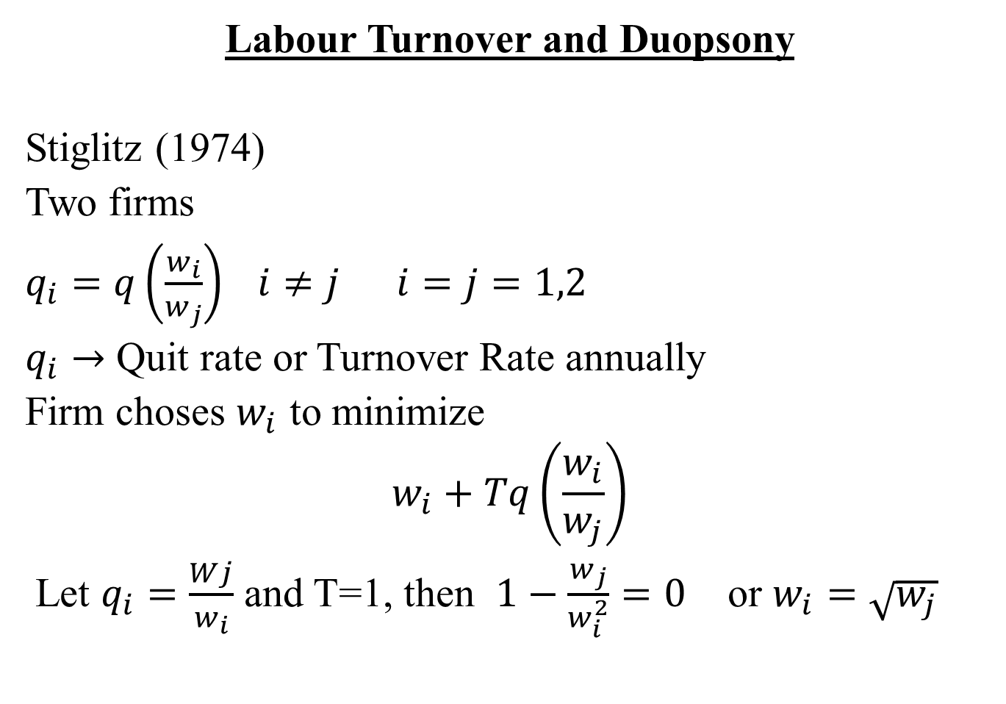
Labour Turnover and Duopsony
Stiglitz (1974)
Two firms
$q_{i}=q\left(\frac{w_{i}}{w_{j}}\right) i≠j i=j=1,2$
$q_{i}→$ Quit rate or Turnover Rate annually
Firm choses $w_{i}$ to minimize
$$w_{i}+Tq\left(\frac{w_{i}}{w_{j}}\right)$$
Let $q_{i}=\frac{Wj}{w_{i}}$ and T=1, then $1−\frac{w_{j}}{w_{i}^{2}}=0$ or $w_{i}=\sqrt{w_{j}}$

Slide 13
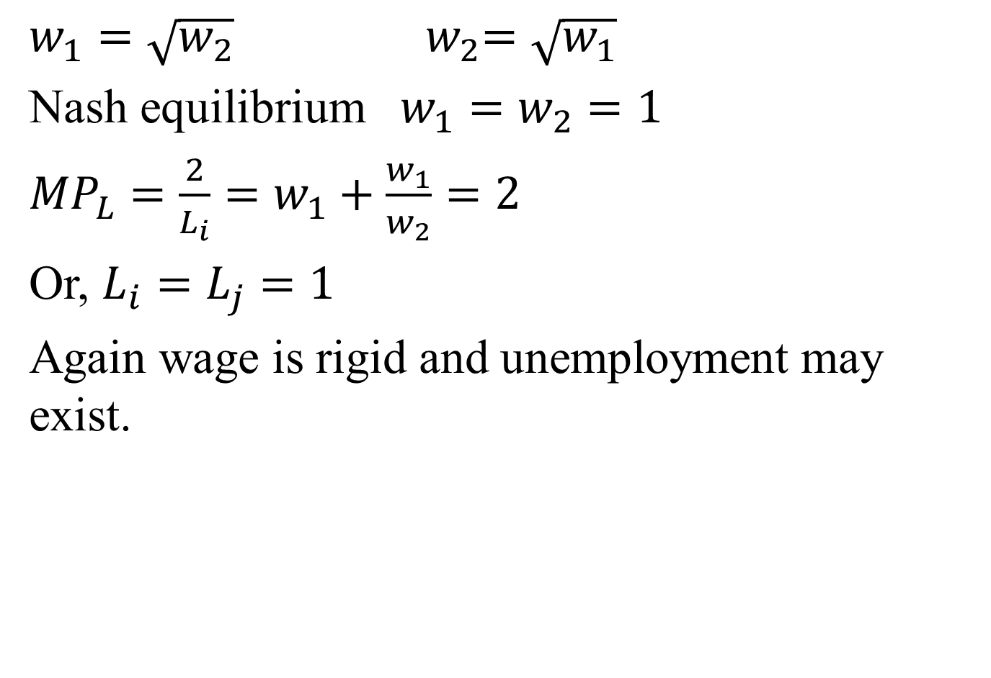
$w_{1}=\sqrt{w_{2}}$ ${ w}_{2}=\sqrt{w_{1}}$
Nash equilibrium $w_{1}=w_{2}=1$
${MP}_{L}=\frac{2}{L_{i}}=w_{1}+\frac{w_{1}}{w_{2}}=2$
Or, $L_{i}=L_{j}=1$
Again wage is rigid and unemployment may exist.

