Slide 1
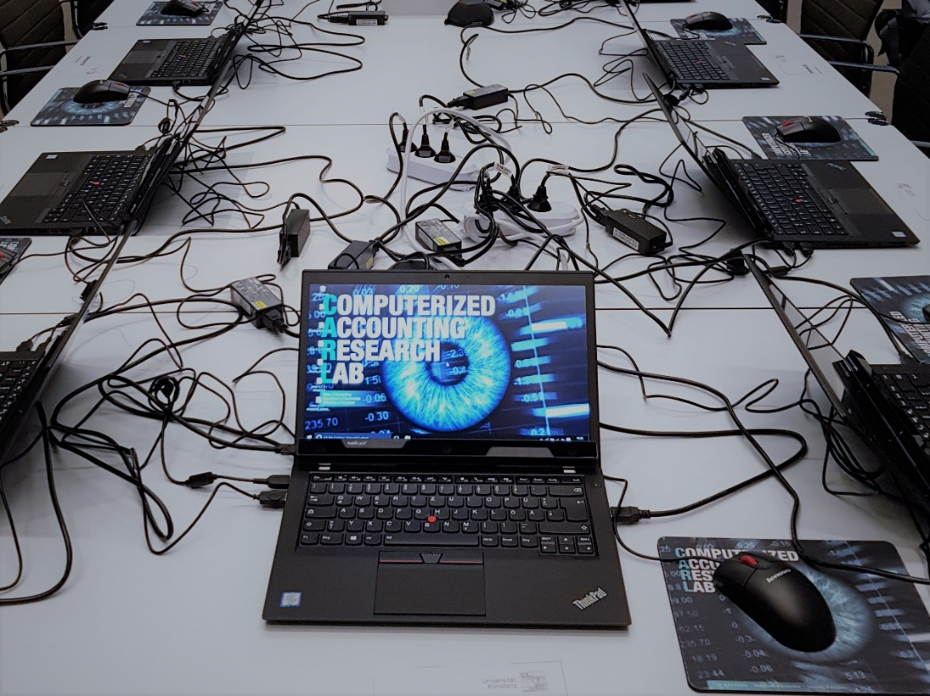
How do analysts read
financial statements?
Preliminary results
from an eye-tracking experiment
DFG-Project Performance Reporting
Maik Lachmann (TU Berlin), Ulrike Stefani (Konstanz),
Arnt Wöhrmann (Gießen)

Slide 2
Motivation
Relevance of Non-GAAP measures
    Analysts seem to regard EBIT / operating profit as comparatively useful
    (interview conducted by the IASB)
    Brouwer, PWC (2007): Review of 2800 financial statements (1300 from 2005 and 1500 from 2004) from companies in the UK, France, and Germany
    The number of line items on the face of the income statement varies between 8 and 48 (IFRS require only 6 line items)
    The number of performance measures varies between 2 and 8 (IFRS only require the separate presentation of net profit or loss)
    96% of the companies report operating profit or EBIT on the face of the income statement, but companies use different definitions of these measures
    Some national regulators prohibit / discourage the presentation of Non-GAAP measures in financial statements (e.g., US, Netherlands, UK); others recommend reporting of Non-GAAP measures (e.g., France)

Slide 3
Motivation
Current regulation on the presentation of Non-GAAP measures
    As part of its plan to promote Better Communication in Financial Reporting, the IASB started the project Primary Financial Statements (June 2014)
    Objective: Examining the content and structure of the primary financial statements, in particular of the statement(s) of financial performance
    The IASB explores, among others,
    requiring an earnings before interest and income tax (EBIT) subtotal
    (EBIT and EBITDA are non-IFRS financial measures)
    providing guidance on the presentation of management performance measures
    better ways of communicating other comprehensive income
    reviewing required minimum line items in primary financial statements
    considering the development of templates for primary financial statements
    IFRS Taxonomy
    Conceptual Framework for Financial Reporting, effective for annual reporting periods beginning on or after 1 January 2020
What kind of information do external addresses regard as decision-useful?
Are there differences between investors and creditors?

Slide 4
Motivation
How do addressees process information contained in financial statements?
    Presentation format matters!
      Maines & McDaniel (2000): More complete and more transparent reporting formats increase non-professional’s information acquisition and use
      Frederickson & Miller (2004): Analysts and non-professional investors differ in their valuation models: Whereas non-professionlas are affected by the presence of pro forma earnings (since they rely on heuristics), analysts are not (since they rely more on well-defined valuation models)
      Lachmann & Stefani & Wöhrmann (2015): Non-professional investors are more likely to acquire the information on changes in credit risk if that information is included in OCI, but the evaluation of firm performance is less biased if fair value gains are included in OCI
      Hirst & Hopkins & Wahlen (2004): Income measurement (all fair-value changes recognized in income vs. some fair-value changes recognized in income, others disclosed in the notes) affects professional equity analysts’ ability to identify a bank’s exposure to interest rate
      Recognition vs. disclosure

Slide 5
Motivation
How do addressees process information contained in financial statements?
    Search strategy: Sequential or directed?
    Using verbal protocols on the individual level, Bouwman et al. (1997) show that the 12 financial analysts included in the study apply a mix of sequential and directed search strategies
    Using a computerized eye-movement retinal imaging system, Hunton & McEwen (1997) (retracted) (claim to) find that more (less) accurate analysts apply a directed (sequential) search strategy
    Grigg & Griffin (2014) use eye-tracking to analyze how 2 (2) participants with (without) accounting knowledge solve key issues in financial analysis
How do professional investors / creditors process information contained in financial statements?

Slide 6
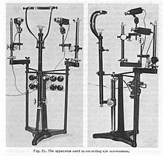
Experimental Design
      Method
    Participants see the financial statements of an existing (but unknown) Company XY and make investment / lending decisions based on this information
    Computerized experiment that combines process data
    (collected by using eye-trackers) with decision data
    Eye-tracking devices use a non-contact, optical method for
    measuring eye motion; they collect data on individual
    eye-movements in an unobtrusive way
    Eye-tracking devices get „cheap“, are small, and can be
    taken nearly everywhere
    (Weakly) incentivized experiment (correct answers in
    the acquisition task / manipulation check increase the
    probability to win an 100 EUR Amazon voucher)
Comparison between investors and creditors
    Professional investors and creditors as participants (exogenous)
    Situations in which the company makes a profit or a loss (manipulated), random assignment of participants to treatments
    Between-subjects design (each participant experiences one treatment only): 2 x 2 design

Slide 7
Experimental Design
Task & data collection
  Calibration of the eye-tracker to the participant’s eyes
  Participants see introductory pages and financial report
  (income statement, balance sheet, cash flow statement)
  of Company XY (2015 and 2014)
Eye-tracker collects process data
  Profit or Loss
  treatment
  Financial statements are still available
Participants state probability to invest / lend 500 Mio. EUR for a project (return:1 percentage point above weighted costs of capital)
  Investment decision
Participants evaluate the performance and the insolvency probability of Company XY
  Evaluation
  Financial statements are not available anymore
Did the report of Company XY contain income statement, statement of the changes in equity, balance sheet, cash flow statement, notes, and / or management report? (6 answers)
  Acquisition
Did the income statement contain certain KPIs? (9 answers)
Was Company XY a profit or a loss firm? (1 answer)
  Manipulation check

Slide 8
Experimental Design
Task & data collection
  Financial statements are not available anymore
Participants state relevance of KPIs for their investment / lending decision
  Weighting
Participants state relevance of KPIs for predicting future cash flows / for measuring current performance
  Interpretation
Participants state relevance of KPIs for measuring core business / additional activities
  Interpretation
Participants state relevance of KPIs for measuring continuous effects / one-off effects
  Interpretation
Questions on risk aversion
  Control
Questions on gender, age, and professional experience
  Demographics
  Information on the number of lottery tickets earned (1 / -1 lottery ticket for each correct / incorrect answer), winner receives 100 € Amazon voucher

Slide 9
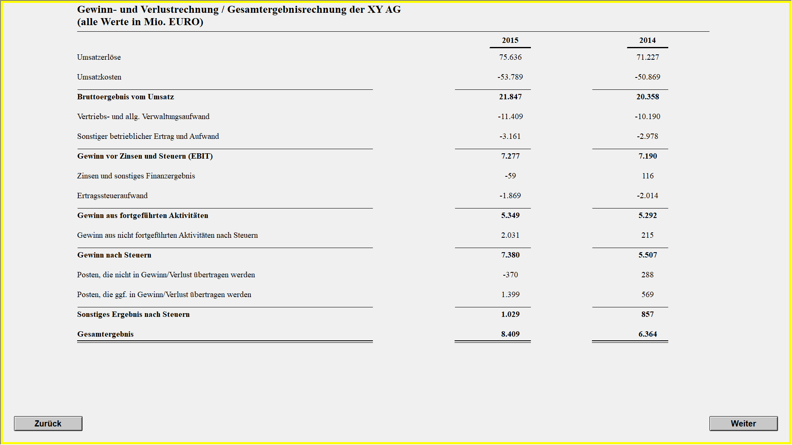
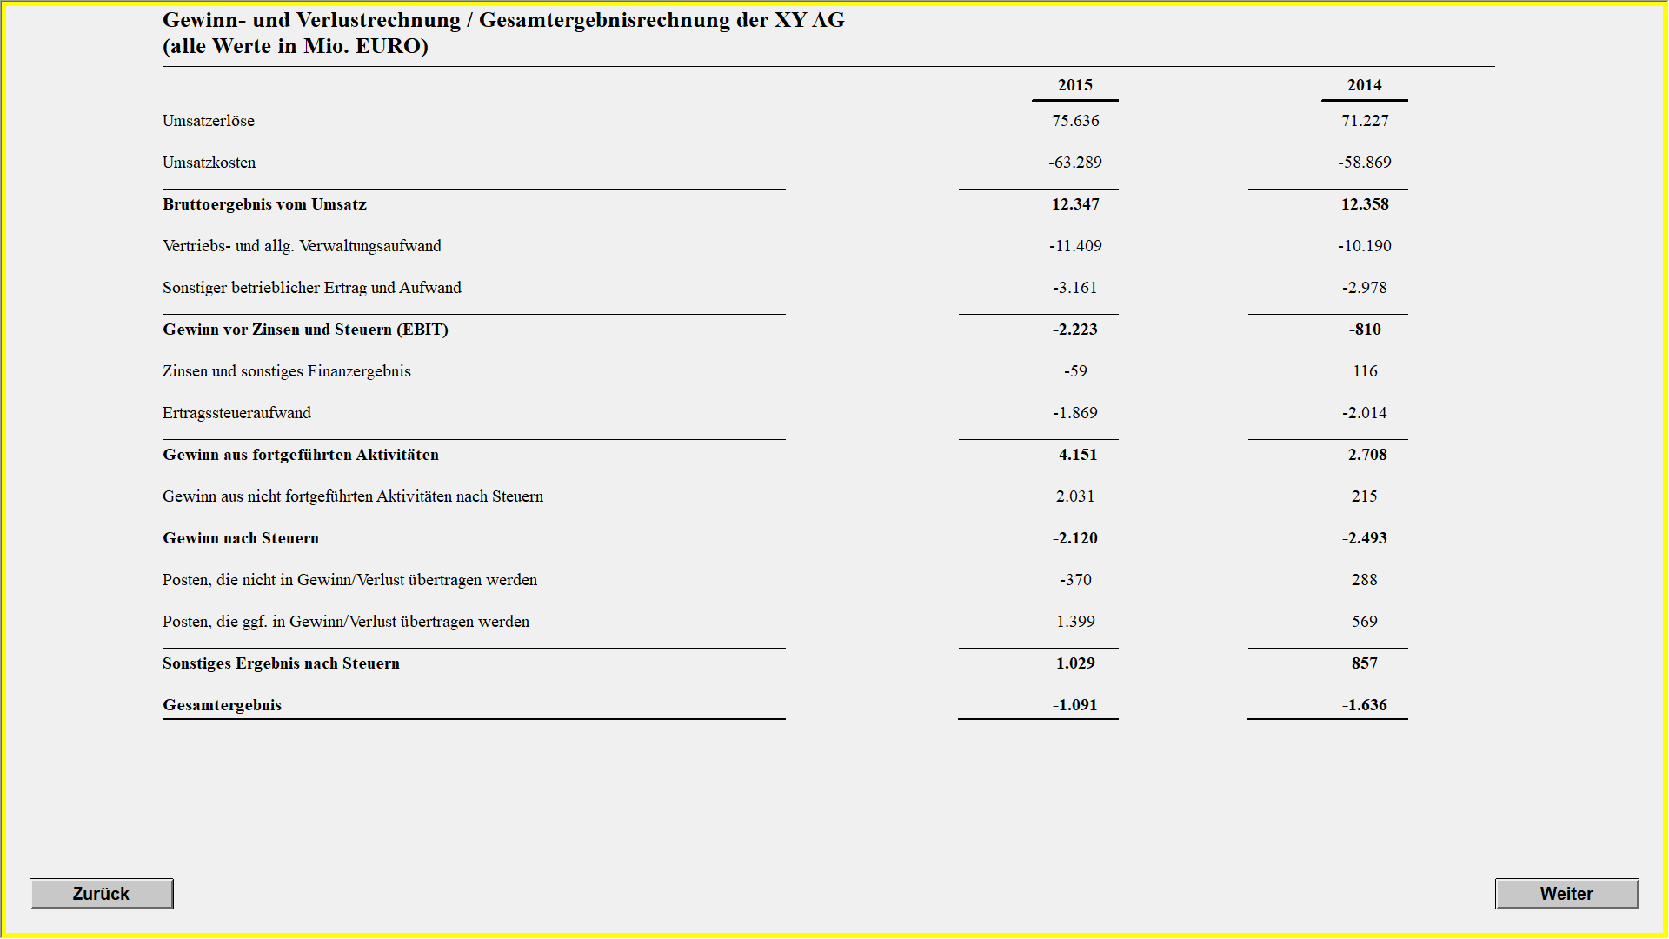
Profit
Loss
Provisions increase by
9500 more in the loss than in the profit treatment: Costs of goods sold are by 9500 higher in the loss than in the profit treatment
In 2015, all KPIs are by 9500 lower in the loss than in the profit treatment; already in 2014, comprehensive income is by 8000 lower in the loss than in the profit treatment since costs of goods sold are by 8000 higher

Slide 10
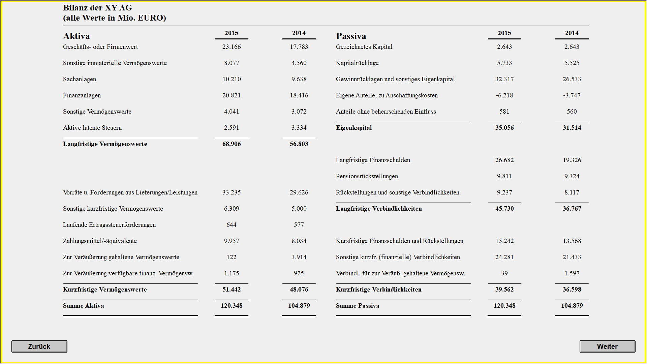

Reserves (and equity) decrease by 9500 more in the loss than in the profit treatment (increase of 5784): Total decrease of 3716
Profit
Loss
Reserves in the loss treatment are already in 2014 by 8000 lower than in the profit treatment
Provisions increase by
9500 more in the loss than in the profit treatment (increase of 1120): Total increase of 10620 in the loss treatment
Provisions in the loss treatment are already in 2014 by 8000 higher than in the profit treatment

Slide 11
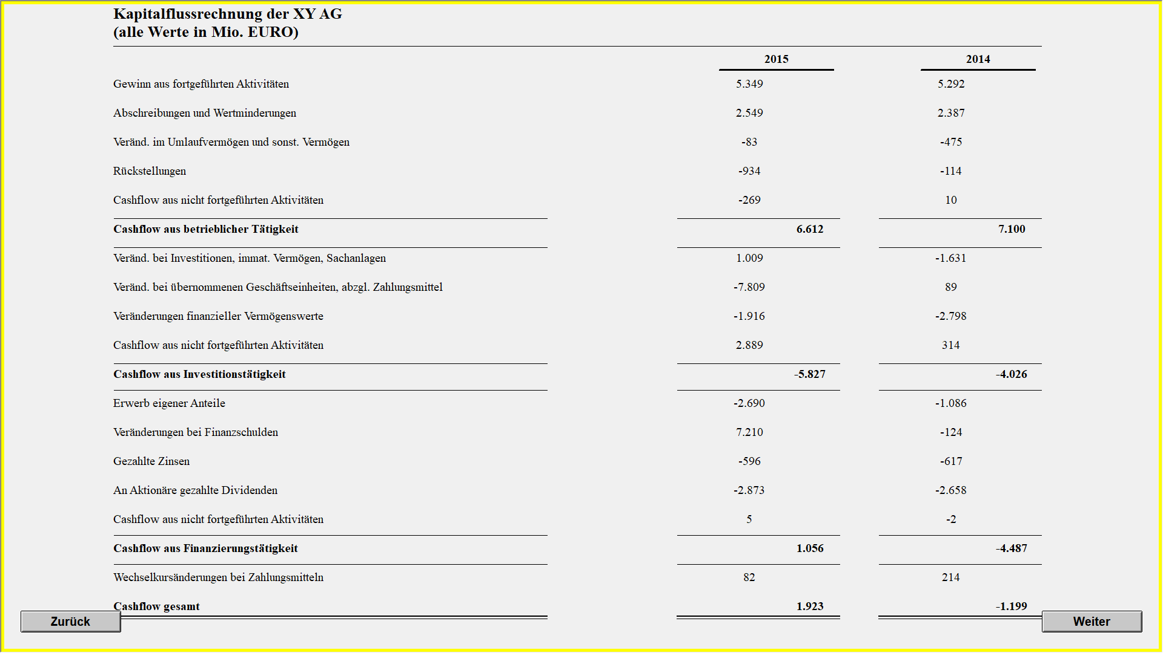

Loss
Profit
Net income from continuing operations is by 9500 (2015) and by 8000 (2014) lower in the loss than in the profit treatment
The increase in provisions is by 9500 higher in the loss than in the profit treatment

Slide 12
Collecting Process Data: Eye-Tracking
Terms
    Hypothesis: There is a link between eye movements and cognitive processes
    Area of Interest (AOI): Pre-defined area on the screen
    Screen measures 1080 x 1920 Pixel
    One item (e.g., KPI) measures 30 x 100 Pixel, the distance to the next item above / below is 18 Pixel
    AOI is 48 x 100 Pixel: The AOIs adjoin, but do not overlap
    Transition: Movement from one AOI to the next
    Fixation: Period for which gaze is hold still; stabilized position of the retina
    All information is mainly acquired during a fixation
    The length of a fixation is usually an indication of information-processing or cognitive activities
    Are the following 7 measurements (frequency of 60 Hertz: 116.67 ms) within a range of 40 Pixel? Fixation means that for 116.67 ms, all consecutive measurements have a distance of 40 Pixel, at the maximum
    Dwell-Time: The total amount of time a participant fixates or simply glances within an AOI

Slide 13
Participants
Data collection process
 |  |  | Investors |  |  | Creditors
City | Company / Event | Date | Profit | Loss | Total | Profit | Loss | Total | Total
Frankfurt | Large Bank | 20.06.2017 | 0 | 0 | 0 | 8 | 5 | 13 | 13
Düsseldorf | Large Bank | 21.06.2017 | 0 | 0 | 0 | 6 | 8 | 14 | 14
Zürich | Large Bank | 14.03.2018 | 2 | 0 | 2 | 2 | 3 | 5 | 7
Stuttgart | Invest | 13.-14.04.2018 | 2 | 4 | 6 | 1 | 6 | 7 | 13
Berlin | Investment Company | 29.06.2018 | 3 | 3 | 6 | 0 | 0 | 0 | 6
Frankfurt | Large Bank | 30.08.2018 | 0 | 0 | 0 | 2 | 2 | 4 | 4
Stuttgart | Large Bank | 12.11.2018 | 2 | 3 | 5 | 6 | 0 | 6 | 11
Frankfurt | Eigenkapitalforum | 26.-28.11.2018 | 15 | 15 | 30 | 0 | 1 | 1 | 31
Köln | Large Bank | 14.01.2019 | 0 | 0 | 0 | 8 | 10 | 18 | 18
 |  |  | 24 | 25 | 49 | 33 | 35 | 68 | 117

Slide 14
Participants
Demographics
 | Investors |  |  | Creditors
 | Profit | Loss | Total | Profit | Loss | Total | Total
Females | 8.33% | 8.00% | 8.16% | 33.33% | 40.00% | 36.76% | 24.79%
Age (years) | 41.5 | 42.5 | 42.0 | 40.9 | 40.6 | 40.8 | 41.3
Education
General Certificate of Secondary Education | 0.0% | 12.0% | 6.1% | 6.1% | 5.7% | 5.9% | 6.0%
General Qualification for University Entrance | 50.0% | 64.0% | 57.1% | 51.5% | 65.7% | 58.8% | 58.1%
Vocational Education | 20.8% | 20.0% | 20.4% | 27.3% | 40.0% | 33.8% | 28.2%
Certified Bank Specialist (Bankfachwirt) | 0.0% | 4.0% | 2.0% | 15.2% | 8.6% | 11.8% | 7.7%
Banking Officer (Bankbetriebswirt) | 0.0% | 4.0% | 2.0% | 15.2% | 2.9% | 8.8% | 6.0%
Bachelor’s Degree | 29.2% | 28.0% | 28.6% | 18.2% | 34.3% | 26.5% | 27.4%
Diploma Certificate | 50.0% | 44.0% | 46.9% | 51.5% | 54.3% | 52.9% | 50.4%
Master’s Degree | 20.8% | 32.0% | 26.5% | 30.3% | 28.6% | 29.4% | 28.2%
PhD | 4.2% | 12.0% | 8.2% | 6.1% | 8.6% | 7.4% | 7.7%
Other | 29.2% | 28.0% | 28.6% | 9.1% | 2.9% | 5.9% | 15.4%
Years in current position | 9.8 (0 to 30) | 9.8 (0 to 25) | 9.8 | 6.1 (0 to 25) | 6.6 (0 to 25) | 6.3 | 7.8
Experience in making investment decisions (years) | 13.1 (1 to 42) | 12.3 (1 to 38) | 12.7 | 10.3 (1 to 28) | 9.3 (1 to 30) | 9.8 | 11.0

Slide 15
Participants
Occupational title
Investors
Analyst / Research Analyst / Investment Analyst / Portfolio Manager / Associate Private Equity | 17
Sales / Broker | 2
Investor | 3
Consultant | 4
Tax / Audit / Legal | 3
Controlling | 1
CEO / Partner / Project Leader | 8
CFO | 1
Board Member | 2
Other | 8
 | 49
Creditors
Credit Analyst | 29
Investment Manager / Investment Analyst | 6
Risk Management | 5
Credit Underwriter / Credit Officer | 2
Advisory Financial / Rating | 5
Product Manager / Sales | 6
CEO | 3
Manager | 6
Other | 6
 | 68

Slide 16
Performance in the Acquisition Task / Manipulation Checks
Lottery tickets (max. 16)
Acquisition task: Presence of …
    Income statement (yes)
    Statement of the changes in equity (no)
    Balance sheet (yes)
    Cash flow statement (yes)
    Notes (no)
    Management report (no)
 | Profit | Loss | Total
Investors | 10.5 (6 to 16) | 11.0 (6 to 16) | 10.8
Creditors | 11.3 (6 to 16) | 11.9 (4 to 16) | 11.6
Total | 10.9 | 11.53 | 11.2
*
Manipulation checks: Presence of …
    Gross profit (Bruttoergebnis vom Umsatz) (yes)
    Earnings before interest, taxes, and depreciation (EBITDA) (no)
    Earnings before interest and taxes (Gewinn vor Zinsen und Steuern) (EBIT) (yes)
    Earnings before taxes (EBT) (no)
    Net income from continuing operations (Gewinn aus fortgeführten Aktivitäten) (yes)
    Net income from non-continuing operations after taxes (Gewinn aus nicht fortgeführten Aktivitäten nach Steuern) (yes)
    Net income (Gewinn nach Steuern) (yes)
    Other comprehensive income after taxes (sonstiges Ergebnis nach Steuern) (yes)
    Comprehensive income (Gesamtergebnis) (yes)
    Loss / profit in 2015

Slide 17
Performance in the Acquisition Task / Manipulation Checks
Item | Correct answers (%)
Income statement (yes) | 99.1%
Statement of the changes in equity (no) | 94.9%
Balance sheet (yes) | 99.1%
Cash flow statement (yes) | 99.1%
Notes (no) | 100.0%
Management report (no) | 100.0%
Gross profit (Bruttoergebnis vom Umsatz) (yes) | 88.9%
Earnings before interest, taxes, and depreciation (EBITDA) (no) | 92.3%
Earnings before interest and taxes (EBIT) (G. vor Zinsen und St.) (yes) | 79.5%
Earnings before taxes (EBT) (no) | 51.3%
Net income from continuing operations (G. aus fortg. Akt.) (yes) | 83.8%
Net income from non-cont. ops. after taxes (G. aus n.-fortg. Akt. nach St.) (yes) | 59.8%
Net income / Earnings after taxes (EAT) (Gewinn nach Steuern) (yes) | 87.2%
Other comprehensive income after taxes (sonst. Erg. nach St.) (yes) | 43.6%
Comprehensive income (Gesamtergebnis) (yes) | 91.5%
Loss / profit | 85.0% / 100.0%
Participants calculated the EBT themselves?
Probably KPI is not relevant …
Probably OCI is not relevant …

Slide 18
Performance in the Acquisition Task / Manipulation Checks
Key findings
    Participants mainly correctly answered the questions regarding the presence of the financial report’s elements and regarding the existence of a profit / loss
    Participants more often incorrectly answered the questions on the presence of certain KPIs
    The position of the KPI in the income statement does not seem to affect the likelihood of a correct answer
    The difference between investors and creditors in the frequency of correct answers is not significant

Slide 19
Risk Aversion
On average, are you willing to take risks or do you try to avoid risks?
 | Profit | Loss | Total
Investors | 5.7 | 6.6 | 6.1
Creditors | 4.8 | 4.6 | 4.7
Total | 5.2 | 5.5 | 5.3
  (0: „not willing to take risks“; 10: „risk-loving“)
***
Driving a car
Financial investments
Leisure & sports
 | Profit | Loss | Total
Inv. | 5.0 | 4.6 | 4.8
Cred. | 4.1 | 4.3 | 4.2
Total | 4.5 | 4.5 | 4.5
 | Profit | Loss | Total
Inv. | 6.1 | 6.5 | 6.3
Cred. | 4.0 | 4.6 | 4.3
Total | 4.9 | 5.4 | 5.1
 | Profit | Loss | Total
Inv. | 4.8 | 5.8 | 5.3
Cred. | 5.3 | 5.7 | 5.5
Total | 5.1 | 5.8 | 5.4
***
*
Professional career
Health
Trust in other people
 | Profit | Loss | Total
Inv. | 6.5 | 6.6 | 6.5
Cred. | 5.0 | 5.7 | 5.3
Total | 5.6 | 6.1 | 5.8
 | Profit | Loss | Total
Inv. | 3.7 | 3.3 | 3.5
Cred. | 3.0 | 3.8 | 3.4
Total | 3.3 | 3.6 | 3.5
 | Profit | Loss | Total
Inv. | 3.8 | 5.1 | 4.5
Cred. | 4.6 | 5.8 | 5.2
Total | 4.3 | 5.5 | 4.9
***
*
**

Slide 20
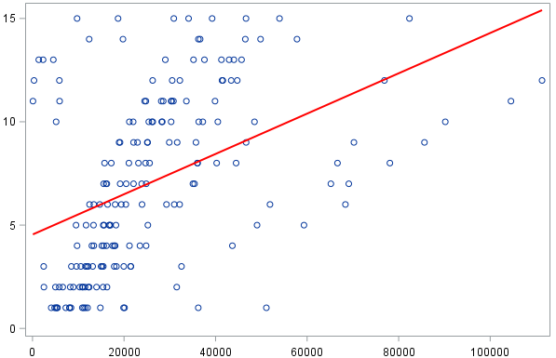
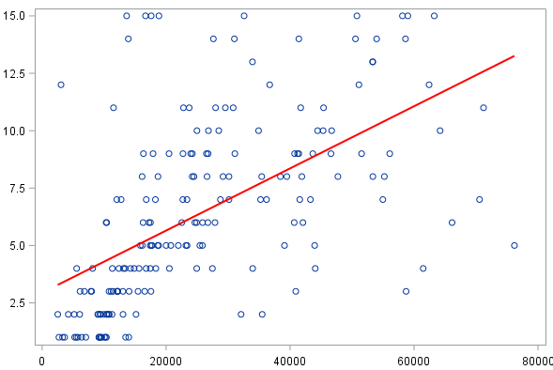
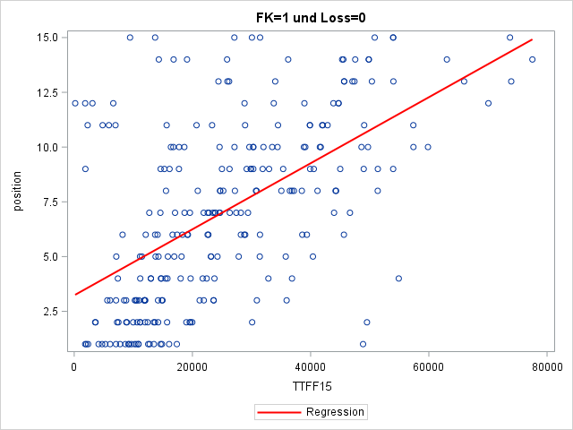
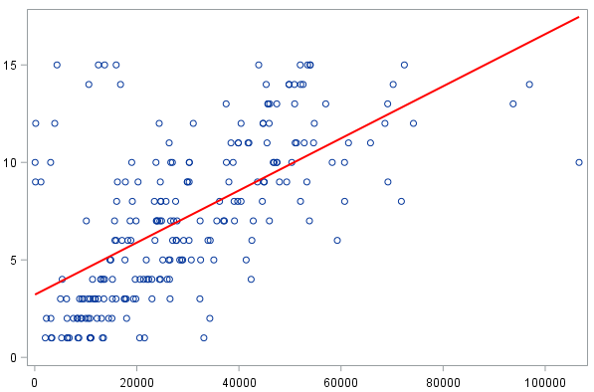
What Kind of Search Strategy is Applied?
Position of KPIs on the screen (revenues to CI) and Time to First Fixation (2015)
Investors x Profit
Investors x Loss
Intercept | 11791***
Position | 2053***
F | 46.34***
Adj. R² | 0.2
Intercept | 10279***
Position | 2406***
F | 89.40***
Adj. R² | 0.32
Creditors x Profit
Creditors x Loss
Intercept | 10195***
Position | 2166***
F | 122***
Adj. R² | 0.32
Intercept | 8727***
Position | 2887***
F | 142***
Adj. R² | 0.38

Slide 21
Loss
2
Profit
15
1
1
3
2
4
3
5
4
6
5
8
6
11
9
12
7
10
12
9
8
15
11
7
14
13
13
14
10
Investors x Profit
Investors x Loss
Order based on Time to First Fixation on value given for year 2015
as participants saw the screen for the first time

Slide 22
Profit
Loss
1
1
2
2
3
3
4
4
5
5
6
6
7
7
11
9
10
8
12
11
8
13
9
12
15
15
14
14
13
10
Creditors x Profit
Creditors x Loss
Order based on Time to First Fixation on value given for year 2015
as participants saw the screen for the first time

Slide 23
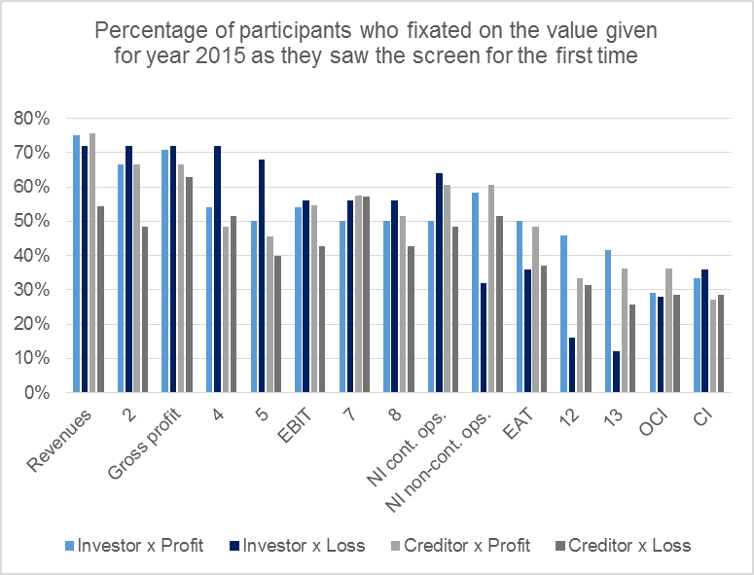
What Kind of Search Strategy is Applied?
Percentage of participants who fixated on the KPIs on the screen
Findings
    During the first visit, more participants fixate on items in the upper part (including EBIT) than on items in the lower part (including OCI and CI) of the income statement

Slide 24
What Kind of Search Strategy is Applied?
Entropy in the scan path
    „Entropy indicates the randomness in the scan pattern … a high resulting value is aligned with a preference for exploration, while low values indicate data with transitions mainly between a few AOIs in the ordered manner.“
    (H_{olmquist} & A_{ndersson} (2017), p. 480)
    Low value: ordered search strategy
    High value: explorative search strategy
    Results:
    Mean Entropy values:
    The difference between investors and creditors is not significant (ANOVA)
    Experience in making investment / lending decisions is associated with lower Entropy values: More experienced participants apply a more ordered search strategy (ANOVA, < 1%)
 | Profit | Loss
Investors | 5.38 | 5.72
Creditors | 5.66 | 5.05

Slide 25
What Kind of Search Strategy is Applied?
Key findings
    Participants mainly apply an ordered search strategy, in particular for the upper part of the income statement
    up to earnings before interest, taxes, and depreciation (EBITDA) in the profit treatment
    and even up to net income from continuing operations (Gewinn aus fortgeführten Aktivitäten) in the loss treatment
    The positions shown in the lower part of the income statement seem to be of lower interest
    Investors and creditors both seem to apply an ordered search strategy
    Those participants with above-median experience in making investment / lending decisions apply a more ordered search strategy

Slide 26
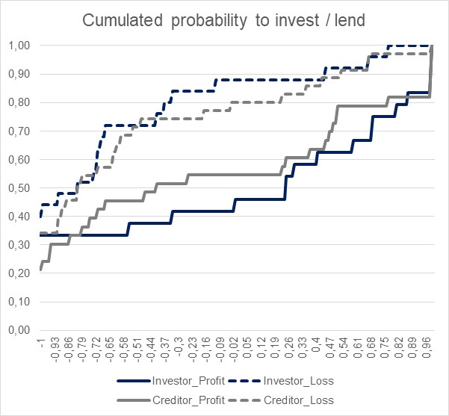
How is Company XY Evaluated?
Decision data on the probability to invest / lend
  (-1: „highly unlikely“;
  1: „highly likely“)
Findings
    In case of a loss, the probability to invest / lend is significantly lower
    (ANOVA, < 1%)
    There is no significant difference between investors and creditors in the probability to invest / lend (ANOVA)
 | Profit | Loss
Inv. | 0.00 | - 0.61
Cred. | - 0.14 | - 0.52
***

Slide 27
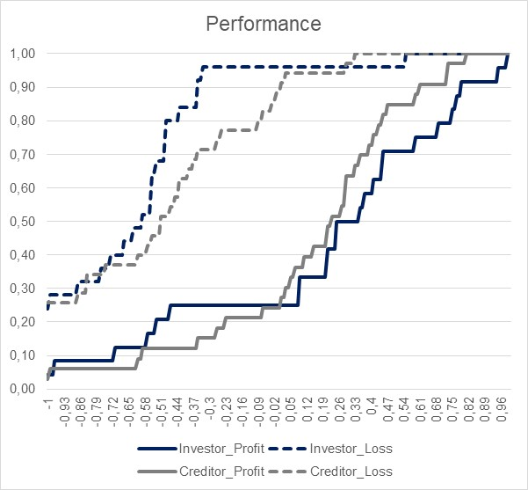
How is Company XY Evaluated?
Decision data on the evaluation of the performance of Company XY
  (-1: „extremely poor“;
  1: „extremely good“)
Findings
    In case of a loss, the performance is seen significantly more unfavorable
    (ANOVA, < 1%)
    There is no significant difference between investors and creditors in the evaluation of the performance of Company XY (ANOVA)
 | Profit | Loss
Inv. | 0.19 | - 0.62
Cred. | 0.14 | - 0.51
***

Slide 28
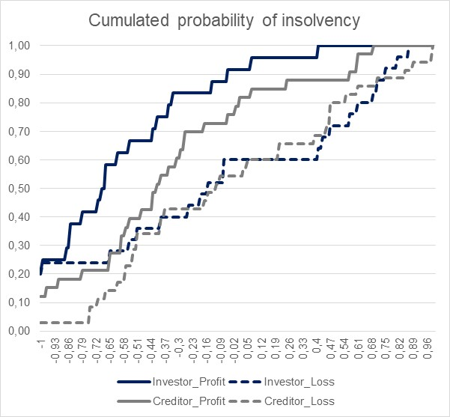
How is Company XY Evaluated?
Decision data on the probability of insolvency
  (-1: „highly unlikely“;
  1: „highly likely“)
Findings
    In case of a loss, insolvency is regarded as significantly more likely (ANOVA, < 1%)
    There is no significant difference between investors and creditors regarding the perceived probability of insolvency (ANOVA)
 | Profit | Loss
Inv. | - 0.60 | - 0.08
Cred. | - 0.33 | - 0.02
***

Slide 29
Which KPIs are Relevant for Decision-Making?
Decision data on KPIs’ relevance for making investment / lending decisions
KPI | Investor x Profit |  | Investor x Loss |  | Creditor x Profit |  | Creditor x Loss
 | mean | rank | mean | rank | mean | rank | mean | rank
Gross profit (Bruttoergebnis vom Umsatz) | 0.86 | 4 | 1.09 | 3 | 1.01 | 3 | 1.22 | 4
Earnings before interest and taxes (EBIT) (Gewinn vor Zinsen und Steuern) | 1.19 | 1 | 1.57 | 1 | 1.41 | 1 | 1.49 | 1
Net income from continuing operations (Gewinn aus fortg. Akt.) | 0.97 | 3 | 1.38 | 2 | 1.36 | 2 | 1.43 | 2
Net income from non-cont. ops. after taxes (Gewinn aus nicht fortg. Akt. nach Steuern) | 0.38 | 6 | 0.65 | 6 | 0.46 | 6 | 0.76 | 6
Net income / Earnings after Taxes (EAT) (Gewinn nach Steuern) | 0.97 | 3 | 1.06 | 4 | 0.98 | 4 | 1.25 | 3
Other comprehensive income after taxes (sonst. Ergebnis nach Steuern) | 0.49 | 5 | 0.46 | 7 | 0.43 | 7 | 0.69 | 7
Comprehensive income (Gesamtergebnis) | 1.03 | 2 | 1.00 | 5 | 0.97 | 5 | 1.20 | 5
3
1
2
3
  (-1: „unimportant“; 1: „very important“ → +1)

Slide 30
Which KPIs are Relevant for Decision-Making?
Decision data on KPIs’ relevance for making investment / lending decisions
    If there‘s a loss, the following KPIs are perceived as significantly more important (ANOVA):
    Gross profit (Bruttoergebnis vom Umsatz) (10%)
    Earnings before interest and taxes (EBIT) (Gewinn vor Zinsen und Steuern) (5%)
    Net income from continuing operations (Gewinn aus fortg. Akt.) (10%)
    Net income from non-cont. ops. after taxes (Gewinn aus nicht fortg. Akt. nach Steuern) (1%)
    Creditors regard the net income from continuing operations (Gewinn aus fortg. Akt.) as significantly more important than investors do (10%)

Slide 31

4
1
3
6
3
5
2
Investors x Profit
Heatmap based on average number of fixations, scale based on all participants

Slide 32

3
1
2
6
4
7
5
Creditors x Profit
Heatmap based on average number of fixations, scale based on all participants

Slide 33

3
1
2
6
4
7
5
Investors x Loss
Heatmap based on average number of fixations, scale based on all participants

Slide 34

4
1
2
6
3
7
5
Creditors x Loss
Heatmap based on average number of fixations, scale based on all participants

Slide 35
Which KPIs are Relevant for Decision-Making?
Correlation between decision data on KPIs’ relevance for making investment / lending decisions and Number of Fixations (Dwell)
KPI | Rele-vance | Fixa-tions | Correlation Relevance & Fixations | Dwell | Correlation Relevance & Dwell
Gross profit (Bruttoergebnis vom Umsatz) | 1.06 | 78.77 | 0.10 | 3058.99 | 0.15
Earnings before interest and taxes (EBIT) (Gewinn vor Zinsen und Steuern) | 1.42 | 70.75 | 0.21 ** | 2774.88 | 0.23 **
Net income from continuing operations (Gewinn aus fortg. Akt.) | 1.31 | 53.36 | - 0.00 | 2426.53 | 0.03
Net income from non-cont. ops. after taxes (Gewinn aus nicht fortg. Akt. nach Steuern) | 0.58 | 48.84 | 0.04 | 2071.77 | 0.04
Net income / Earnings after Taxes (EAT) (Gewinn nach Steuern) | 1.08 | 42.88 | - 0.01 | 1728.47 | - 0.01
Other comprehensive income after taxes (sonst. Ergebnis nach Steuern) | 0.53 | 22.94 | - 0.03 | 990.50 | - 0.02
Comprehensive income (Gesamtergebnis) | 1.06 | 26.79 | 0.10 | 1076.79 | 0.07

Slide 36
Which KPIs are Relevant for Decision-Making?
Association between Dwell for KPIs and making investment / lending decisions
KPI | Coefficient | Pr > [t]
Constant | - 0.87 | < 0.0001
Gross profit (Bruttoergebnis vom Umsatz) | - 0.00 | 0.23
Earnings before interest and taxes (EBIT) (Gewinn vor Zinsen und Steuern) | 0.00 | 0.01
Net income from continuing operations (Gewinn aus fortg. Akt.) | - 0.00 | 0.22
Net income from non-cont. ops. after taxes (Gewinn aus nicht fortg. Akt. nach Steuern) | 0.00 | 0.14
Net income / Earnings after Taxes (EAT) (Gewinn nach Steuern) | 0.00 | 0.52
Other comprehensive income after taxes (sonst. Ergebnis nach Steuern) | - 0.00 | 0.20
Comprehensive income (Gesamtergebnis) | 0.00 | 0.14
Risk (overall) | 0.06 | 0.04
F | 2.73 | 0.01
Adj. R² | 0.11

Slide 37
Which KPIs are Relevant for Decision-Making?
Key findings
    There are no significant differences between investors and creditors regarding the evaluation of Company XY
    Participants regard the following KPIs as most important for making investment / lending decisions (decision data):
    Earnings before interest and taxes (EBIT) (Gewinn vor Zinsen und Steuern)
    Net income from continuing operations (Gewinn aus fortg. Akt.)
    Gross profit (Bruttoergebnis vom Umsatz) and Earnings after Taxes (EAT) (Gewinn nach Steuern)
    Non-GAAP measures (e.g., gross profit (Bruttoergebnis vom Umsatz) or earnings before interest and taxes (EBIT) (Gewinn vor Zinsen und Steuern) seem more important than GAAP-measures (e.g., comprehensive income (Gesamtergebnis))

Slide 38
Which KPIs are Relevant for Decision-Making?
Key findings
    Heatmaps show that
    Revenues, costs of goods sold, and gross profit receive comparatively more attention than the KPIs that subjects indicated as important
    EBIT also gets some attention (except in the creditors x loss cell), as do several entries in the upper part of the income statement (up to the net income from continuing operations (Gewinn aus fortgeführten Aktivitäten))
    Non-GAAP measures (e.g., gross profit (Bruttoergebnis vom Umsatz) or earnings before interest and taxes (EBIT) (Gewinn vor Zinsen und Steuern) seem more important than GAAP-measures (e.g., Earnings after Taxes (EAT) (Gewinn nach Steuern) or comprehensive income (Gesamtergebnis))
    The values for 2014 do not get much attention
    There are significant correlations of the eye-tracking measures Number of Fixations (and Dwell) with the stated importance of an KPI only for the EBIT
    Dwell on EBIT has a significant association with the decision to invest / lend

Slide 39

Investors x Profit

Slide 40

Creditors x Profit

Slide 41

Profit
Investors x Loss

Slide 42

Profit
Creditors x Loss

Slide 43
Which KPIs are Relevant for Decision-Making?
Key findings
    Heatmaps show that participants focus on these balance sheet items:
    Investors x Profit: Equity (which gets more attention than any KPI from the income statement)
    Investors x Loss: Equity gets less attention
    Creditors x Profit: Long-term financial liabilities
    Creditors x Loss: Long-term financial liabilities get less attention, short-term liabilities gain in importance
    Among the assets, only intangibles, goodwill, and PPE get some attention
    Assets seem not as important as equity / liabilities
    The values from the preceding year do not seem to cause any interest

Slide 44
Investors x Profit

Slide 45

Creditors x Profit

Slide 46

Loss
Profit
Investors x Loss

Slide 47

Loss
Profit
Creditors x Loss

Slide 48
Which KPIs are Relevant for Decision-Making?
Key findings
    Heatmaps show that participants
    Do not seem to show the same interest in the cash flow statement as in the income statement
    This is particularly true for the creditors

Slide 49
Which KPIs are Relevant for Decision-Making?
Number of screen visits
Income Statement | Profit | Loss | Total
Investors | 4.5 | 4.4 | 4.4
Creditors | 6.6 | 6.0 | 6.3
Total | 5.7 | 5.3 | 5.5
Findings
    Creditors visit the income statement significantly more often than investors
    Creditors visit the balance sheet significantly more often than investors
    Creditors visit the cashflow statement significantly more often than investors
***
Balance Sheet | Profit | Loss | Total
Investors | 4.6 | 5.0 | 4.8
Creditors | 6.7 | 5.7 | 6.2
Total | 5.8 | 5.5 | 5.6
***
Cashflow Statement | Profit | Loss | Total
Investors | 3.4 | 3.4 | 3.4
Creditors | 4.7 | 3.8 | 4.2
Total | 4.1 | 3.6 | 3.9
*

Slide 50
Conclusion
Key findings
    EBIT seems to be particularly important for making investment / lending decisions
    This finding is relevant for the regulatory debate on the presentation of Non-GAAP measures:
    Better ways of communicating other comprehensive income? OCI seems not to be very important…
    Reviewing required minimum line items in primary financial statements? Probably a maximum is more helpful….
    Professionals read in an ordered manner
    This finding is relevant for the development of hypotheses on the effects of the presence of information items and the choice of the presentation format

Slide 51
Thank you for your attention …
… and for your comments!
Prof. Dr. Ulrike Stefani
Department of Economics
Tel.: +49 (0) 75 31/88 - 5251
Fax: +49 (0) 75 31/88 - 5257
ulrike.stefani@uni-konstanz.de

