Slide 1
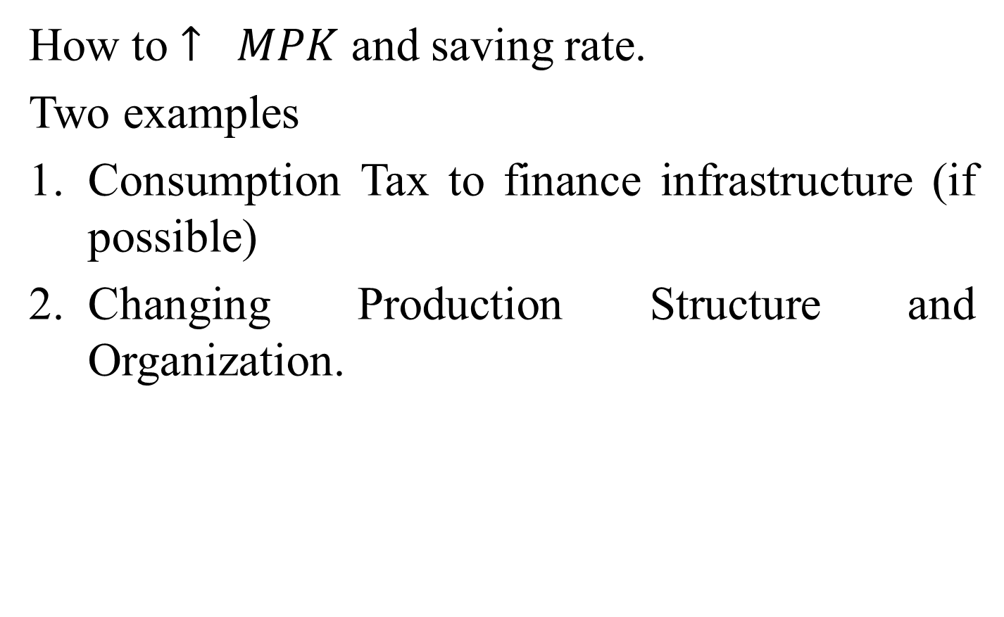
Growth Problem of the Developing World
How to $↑ MPK$ and saving rate.
Two examples
Consumption Tax to finance infrastructure (if possible)
Changing Production Structure and Organization.

Slide 2
The problem now takes as
$$L_{t}≡u\left(c_{t}\right)+βV\left(k_{t+1}\right)+λ_{t}\left[θ\left[zc_{t}\right]f\left(k_{t}\right)−\left(1−z\right)c_{t}−\left(k_{t+1}−k_{t}\right)\right]$$
$Zc_{t}$ is added to $↑$ infrastructure
$θ(zc_{t})$ , $θ^{′}>0$
Steady state solution
$θf^{′}+1=1+ρ$
Or $f^{′}\left(k\right)=\frac{ρ}{θ(Z c)}$ … (2.1)
($k_{0},c_{0})$ steady state values.
Now $k_{0}>k at θ=1$
No Consumption Tax

Slide 3

$$f^{′}\left(k\right)=\frac{ρ}{θ(Zc)}$$
$θ>1$
c
$$c_{0}$$
$$c+k=f(k)$$
$$c ↓ k ↑$$
$$k$$
$$k_{0}$$
Figure – 3.1

Slide 4
Virtual Trade and Endogenous Growth Research Questions
How trade due to separated time zones (virtual trade) can lead to higher rate of growth.
Level and growth effect of trade in the same structure
Growth in an Open Economy , due to David Ricardo in the 19th Century UK. Repeal of the Corn Law (1846)

Slide 5
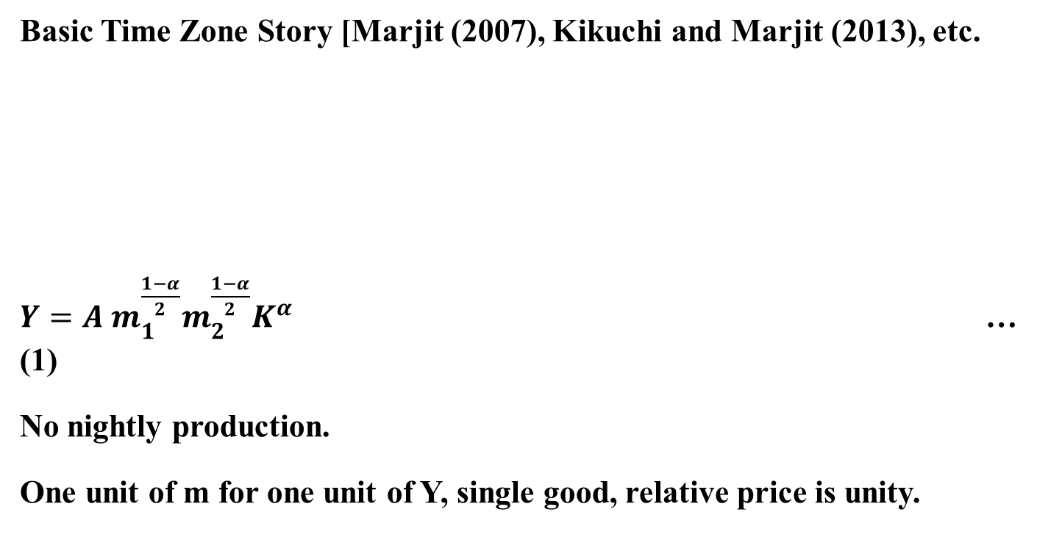
Basic Time Zone Story [Marjit (2007), Kikuchi and Marjit (2013), etc.
$Y=A m_{1}^{\frac{1−α}{2}}m_{2}^{\frac{1−α}{2}}K^{α}$ … (1)
No nightly production.
One unit of m for one unit of Y, single good, relative price is unity.
$$m_{1}$$
$$m_{2}$$
Y
A
day
night
day
B
night
$$A_{1}$$
$$A_{2}$$

Slide 6
Late delivery $⇒$ Carry $m_{1}$too long for $m_{2}$ to appear.
Carry over delay cost
Optimal $m_{10}=\frac{1−α}{2}.\frac{Y}{1+μ}$
$m_{20}=\frac{1−α}{2}.Y$
$Y= A^{1/α}{\left(\frac{1−α}{2}\right)}^{\frac{1−α}{α}}{\left[\frac{1}{1+μ}\right]}^{\frac{1−α}{2α}}K^{α}$ ... (2)
= ${\tilde{A}}_{0}.K$ … (3)
We get the (AK) type model (Rebelo(1991)).

Slide 7
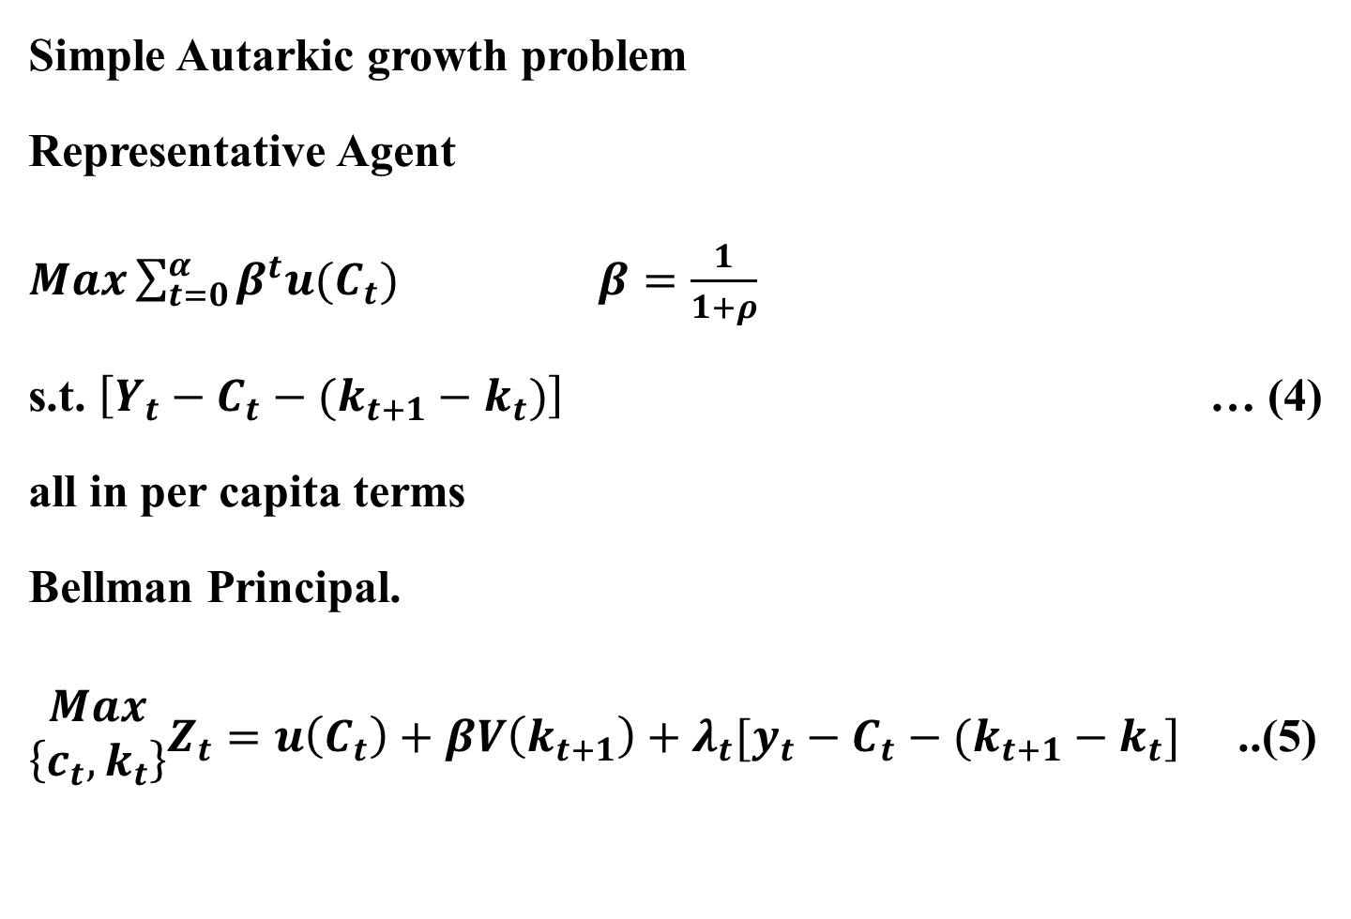
Simple Autarkic growth problem
Representative Agent
$Max\sum_{t=0}^{α}{β^{t}u(C_{t})}$ $β=\frac{1}{1+ρ}$
s.t. $\left[Y_{t}−C_{t}−(k_{t+1}−k_{t})\right]$ … (4)
all in per capita terms
Bellman Principal.
$\begin{matrix}Max \\ \left\{c_{t},k_{t}\right\}\end{matrix}Z_{t}=u\left(C_{t}\right)+βV\left(k_{t+1}\right)+λ_{t}[y_{t}−C_{t}−(k_{t+1}−k_{t}]$ ..(5)

Slide 8
$\frac{u^{′}(c_{t})}{u^{′}(c_{T+1})}≃\tilde{A}−ρ$
$\left(\tilde{A}−ρ\right)$ the rate at which $c$ and $k$ will grow.
$\frac{u^{′}(C_{t})}{u^{′}(C_{t+1})}=\frac{C_{t+1}}{C_{t}}$ in the log linear case
There are other examples.
It is a known result in endogenous growth literature, but not with trade.

Slide 9
If instead of delay in carried over intermediate good, the delay is directly in final good delivery as in Marjit (2007). Then also the same result.

Slide 10

$m_{10}, m_{20}, y_{0}, k$ all will grow at this rate.
Trade
$A→A_{1}→m_{1}$ exported to
India $A_{1}→A_{2}→m_{2}$ shipped back to US.
Trade cost is $τ$
Night India
D I
N I
D I
A
Day USA
N USA
D USA
N USA
$$A_{1}$$
$$A_{2}$$
B

Slide 11
${\tilde{A}}_{F}=A^{1/α}{\left(\frac{1−α}{2}\right)}^{\frac{1−α}{α}}{\left[\frac{1}{1+τ}\right]}^{\frac{1−α}{2α}}$ … (6)
${\tilde{A}}_{F}>{\tilde{A}}_{0}$ iff $τ<μ$
Growth rate $≃{\tilde{A}}_{F}−ρ>{\tilde{A}}_{0}−ρ$
Result
Trade increases level of output AS WELL AS GROWTH RATE, a result very difficult to generate without assumptions beyond trade.
Pointed out by Lucas (1998), more recent works Acemoglu and Ventura (2002), Grossman-Helpman, Romar-Rivera Batiz etc. – No direct effect $→$ need technology, innovation, variety of intermediates, etc.

Slide 12
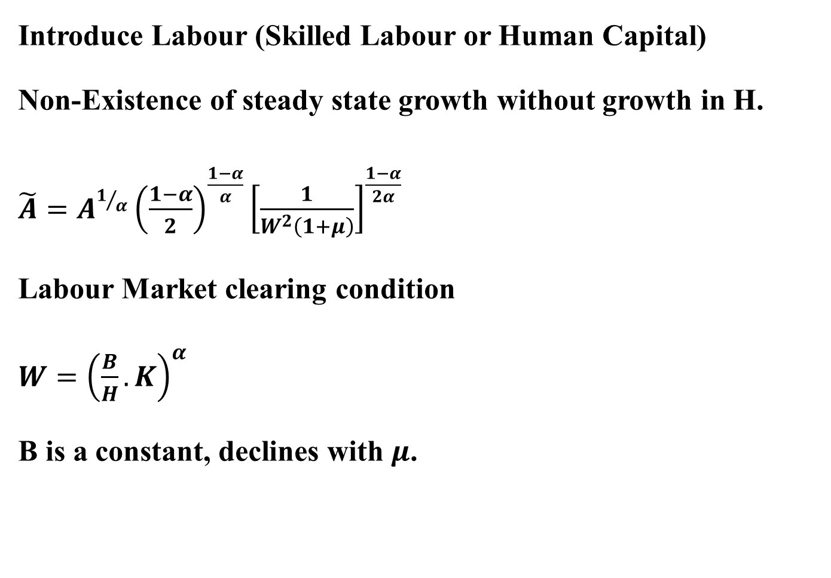
Introduce Labour (Skilled Labour or Human Capital)
Non-Existence of steady state growth without growth in H.
$\tilde{A}=A^{1/α}{\left(\frac{1−α}{2}\right)}^{\frac{1−α}{α}}{\left[\frac{1}{W^{2}\left(1+μ\right)}\right]}^{\frac{1−α}{2α}}$
Labour Market clearing condition
$W={\left(\frac{B}{H}.K\right)}^{α}$
B is a constant, declines with $μ$.

Slide 13
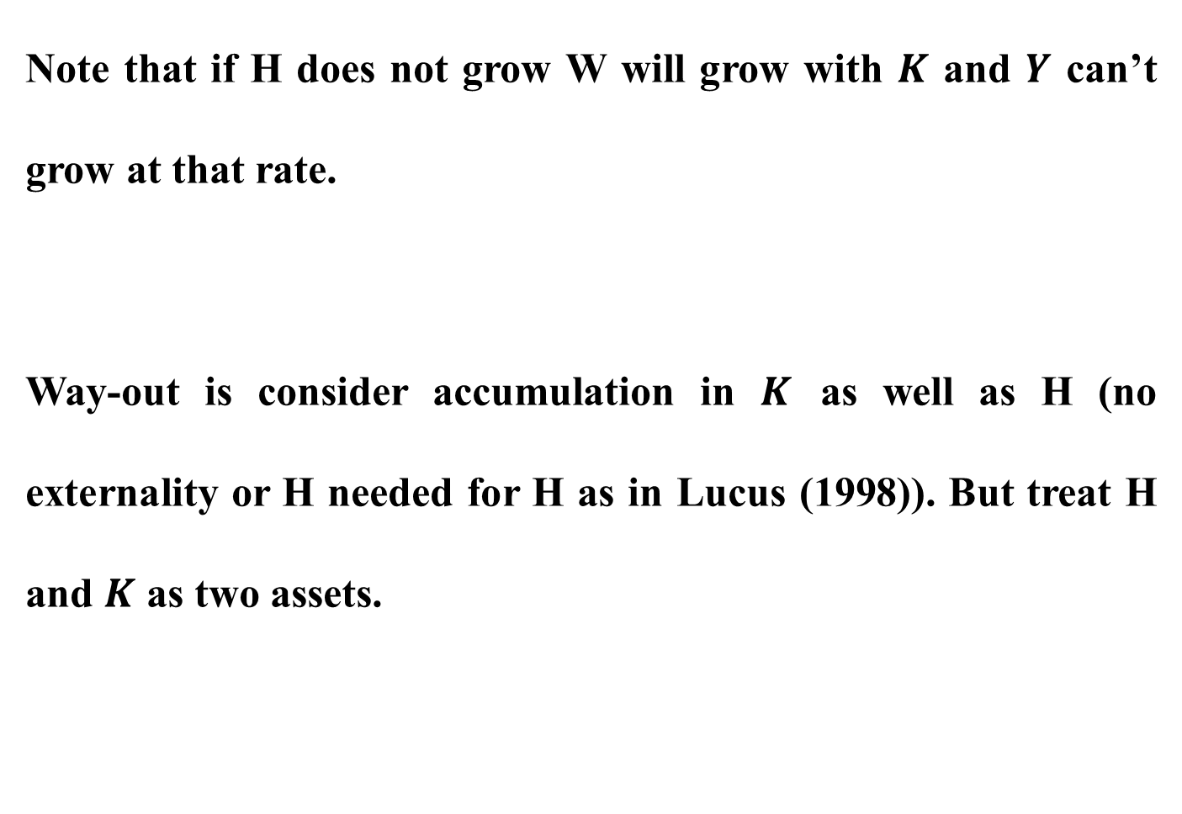
Note that if H does not grow W will grow with $K$ and $Y$ can’t grow at that rate.
Way-out is consider accumulation in $K$ as well as H (no externality or H needed for H as in Lucus (1998)). But treat H and $K$ as two assets.

Slide 14
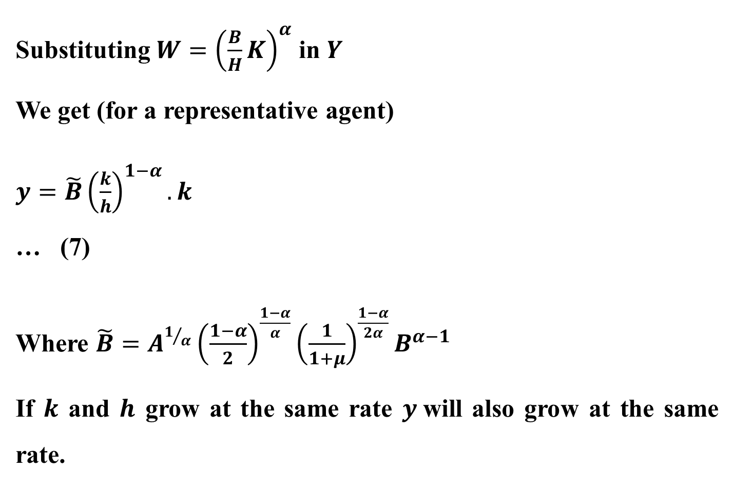
Substituting $W={\left(\frac{B}{H}K\right)}^{α}$ in $Y$
We get (for a representative agent)
$y=\tilde{B}{\left(\frac{k}{h}\right)}^{1−α}.k$ … (7)
Where $\tilde{B}=A^{1/α}{\left(\frac{1−α}{2}\right)}^{\frac{1−α}{α}}{\left(\frac{1}{1+μ}\right)}^{\frac{1−α}{2α}}B^{α−1}$
If $k$ and $h$ grow at the same rate $y$will also grow at the same rate.

Slide 15

Bellman principle yields
$\frac{k_{t}}{h_{t}}=\frac{α}{1−α}$
Growth rate
$\tilde{B}α{\left(\frac{h}{k}\right)}^{1−α}−ρ=\tilde{B}\left(1−α\right){\left(\frac{h}{k}\right)}^{α}−ρ=\tilde{B}−ρ$

Slide 16
Conjecture
It is the case that trade in final goods will not lead to growth, but trade in intermediates may ?

