Slide 1
Credit Market Imperfection
Occupational Choice
Poverty Trap
Production and Trade
1. Workers Vs. Entrepreneurs
$z∈[0 , 1]$ total population.
Each has $k(z)$ amount of capital, $k^{′}>0$

Slide 2
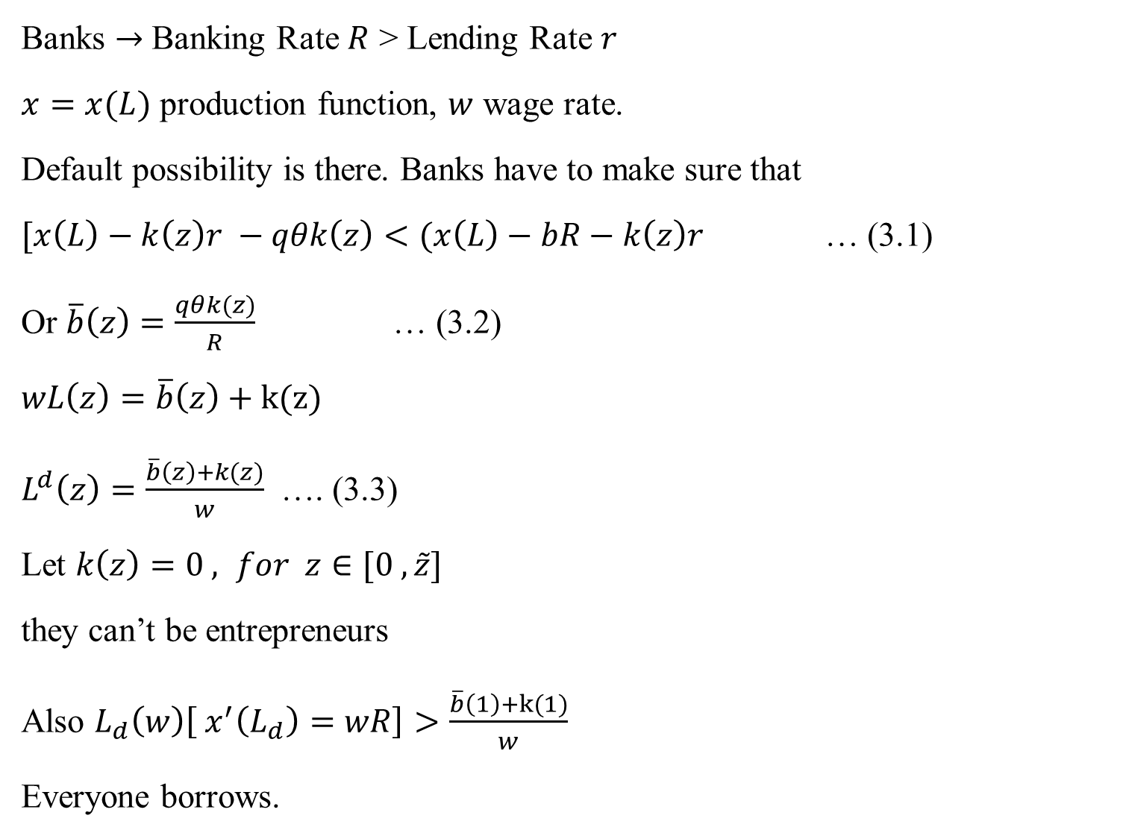
Banks $→$ Banking Rate $R$ > Lending Rate $r$
$x=x(L)$ production function, $w$ wage rate.
Default possibility is there. Banks have to make sure that
$[x\left(L\right)−k\left(z\right)r −qθk\left(z\right)<(x\left(L\right)−bR−k\left(z\right)r$ … (3.1)
Or $\overline{b}\left(z\right)=\frac{qθk(z)}{R}$ … (3.2)
$wL\left(z\right)=\overline{b}\left(z\right)+k(z)$
$L^{d}\left(z\right)=\frac{\overline{b}\left(z\right)+k(z)}{w}$ …. (3.3)
Let $k\left(z\right)=0 , for z∈[0 , \tilde{z}]$
they can’t be entrepreneurs
Also $L_{d}\left(w\right)\left[ x^{′}\left(L_{d}\right)=wR\right]>\frac{\overline{b}\left(1\right)+k(1)}{w}$
Everyone borrows.

Slide 3
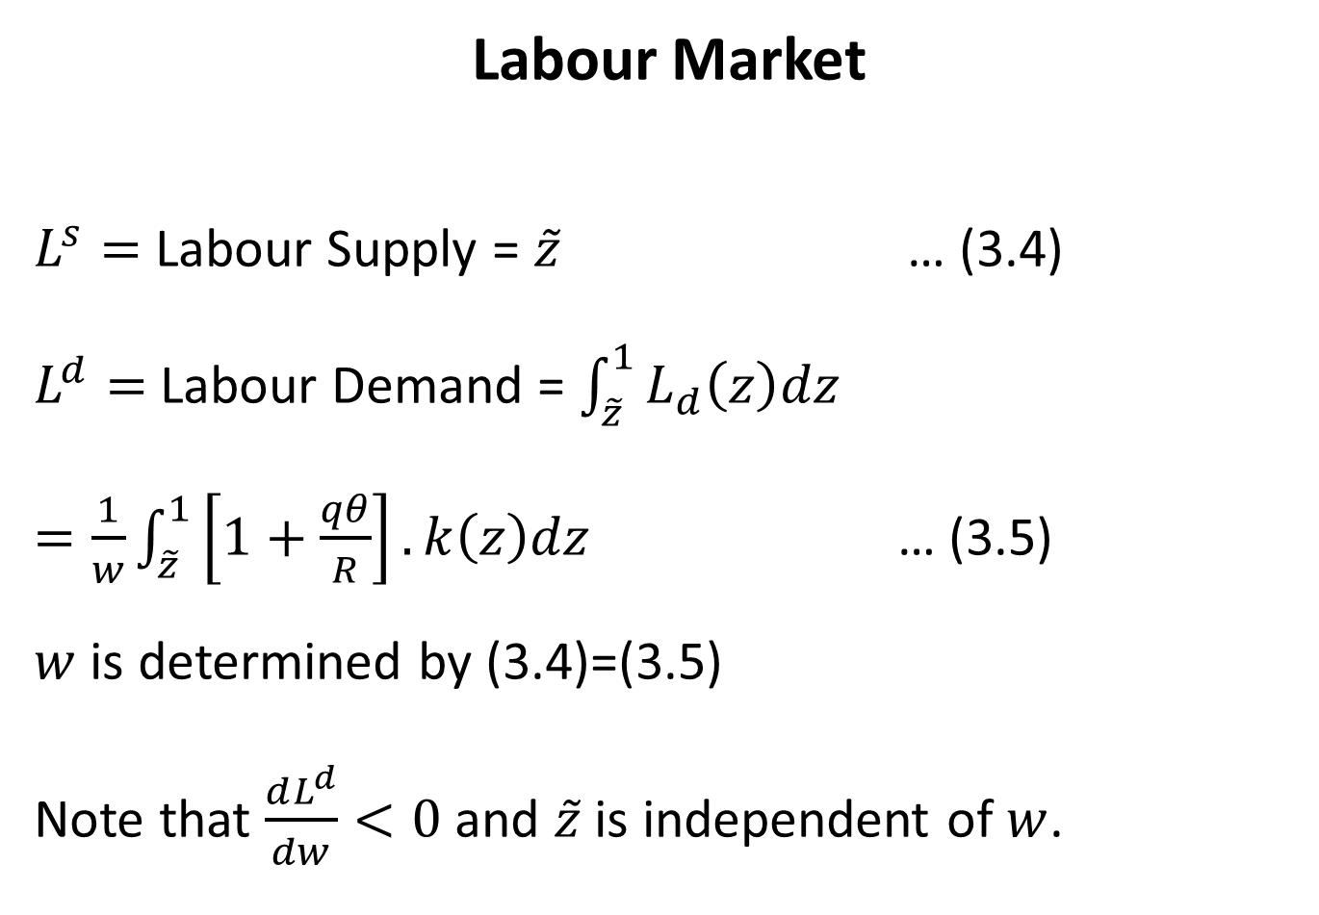
Labour Market
$L^{s}=$ Labour Supply = ${\tilde{z}}_{}$ … (3.4)
$L^{d}=$ Labour Demand = $\int_{\tilde{z}}^{1}{L_{d}\left(z\right)dz}$
$=\frac{1}{w}\int_{\tilde{z}}^{1}{\left[1+\frac{qθ}{R}\right].k\left(z\right)dz}$ … (3.5)
$w$ is determined by (3.4)=(3.5)
Note that $\frac{dL^{d}}{dw}<0$ and $\tilde{z}$ is independent of $w$.

Slide 4
$$w$$
$$L^{s}$$
$$w$$
$$w$$
Fig. 3.1
If more people are poor, $\tilde{z}$ increases, $L^{s} ↑, L^{d}↓ →$ fewer entrepreneurs.
$↑$ Poverty $→$ $↓w →$ poverty $↑$
Inequality Income of the rich
$x\left(L\left(z\right)\right)−k\left(z\right)r−\left[wL\left(z\right)−k\left(z\right)\right]R$
$Y_{R}=x(L\left(z\right)−wL\left(z\right)R+k(z)(R−r)$
$\frac{dY_{R}}{dw}=\left(x^{′}−wR\right)\frac{dL\left(z\right)}{dw}−L\left(z\right)R<0$

Slide 5
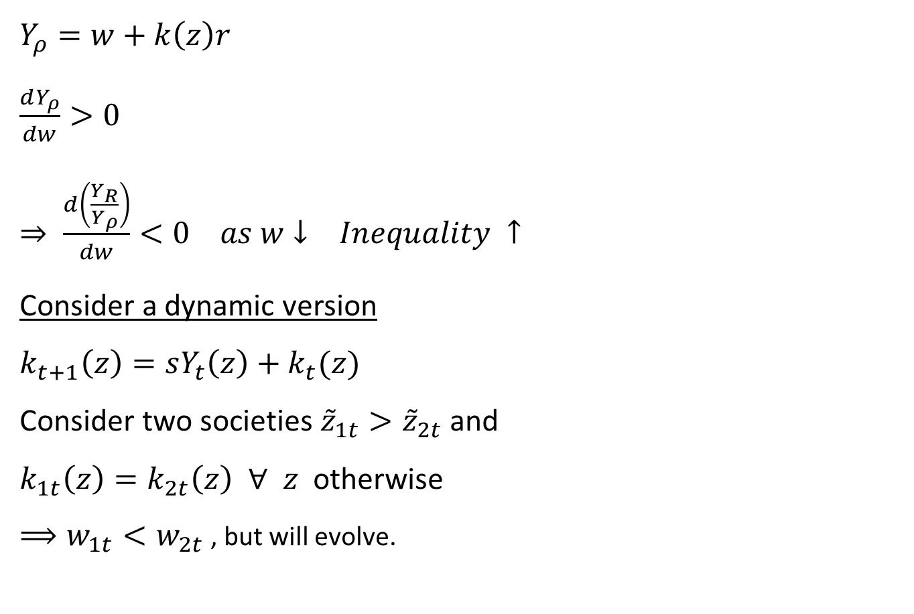
$Y_{ρ}=w+k\left(z\right)r$
$\frac{dY_{ρ}}{dw}>0$
$⇒ \frac{d\left(\frac{Y_{R}}{Y_{ρ}}\right)}{dw}<0 as w↓ Inequality ↑$
Consider a dynamic version
$k_{t+1}\left(z\right)=sY_{t}\left(z\right)+k_{t}(z)$
Consider two societies ${\tilde{z}}_{1t}>{\tilde{z}}_{2t}$ and
$k_{1t}\left(z\right)=k_{2t}\left(z\right) ∀ z$ otherwise
$⟹w_{1t}<w_{2t}$ , but will evolve.

Slide 6
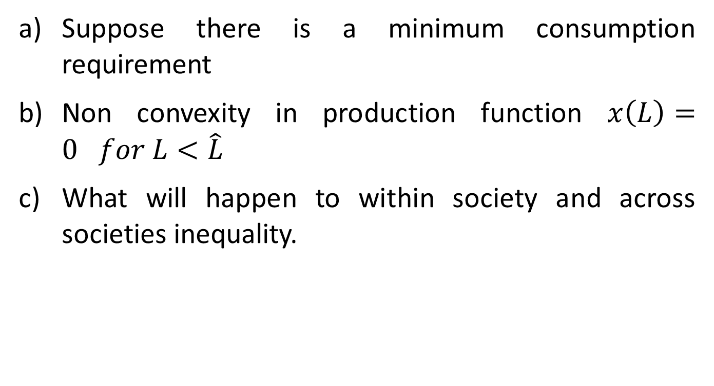
Food For Thought
Suppose there is a minimum consumption requirement
Non convexity in production function $x\left(L\right)=0 for L<\hat{L}$
What will happen to within society and across societies inequality.

Slide 7
Credit Market Imperfection and Human Capital Accumulation
Gal-or and Zaira (1992)
Poverty Trap
Solow Model
$$nk$$
Basic Idea
Non Convexity
Solow Model
Poverty Trap
And Big Push
Stable
$$sf(k)$$
Unstable
Stable
Fig. 3.2
$$k$$

Slide 8
Credit Market Imperfection can generate non-convexity type outcome. Gal-or and Zaira (1992) , Mukherjee and Ray (AER), Banerjee and Duflo (2005)

Slide 9
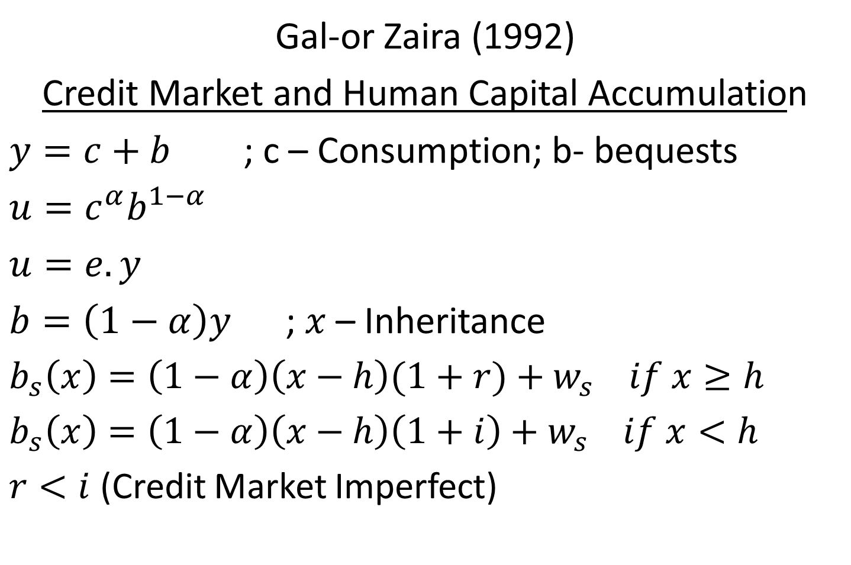
Gal-or Zaira (1992)
Credit Market and Human Capital Accumulation
$y=c+b$ ; c – Consumption; b- bequests
$u=c^{α}b^{1−α}$
$u=e.y$
$b=\left(1−α\right)y$ ; $x$ – Inheritance
$b_{s}\left(x\right)=\left(1−α\right)\left(x−h\right)(1+r)+w_{s} if x≥h$
$b_{s}\left(x\right)=\left(1−α\right)\left(x−h\right)\left(1+i\right)+w_{s} if x<h$
$r<i$ (Credit Market Imperfect)

Slide 10
$u_{s}\left(x\right)=e[\left(x−h\right)\left(1+r\right)+w_{s} x≥h$ $u_{s}\left(x\right)=e\left[\left(x−h\right)\left(1+i\right)+w_{s}\right] x<h$
$$u_{s}(x)$$
$$x$$
$$f$$
$$h$$

Slide 11
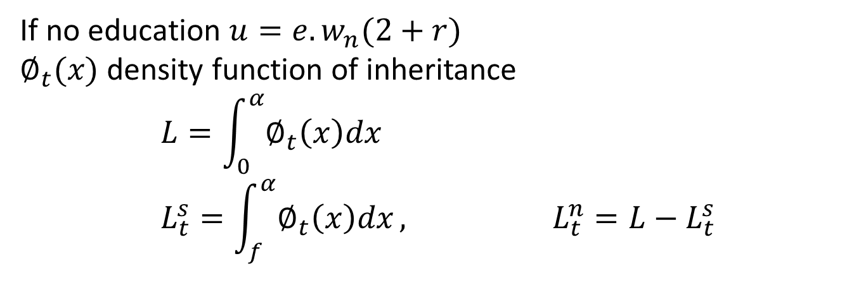
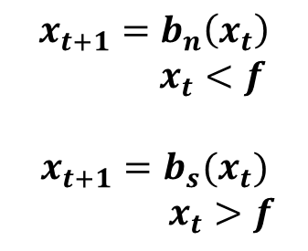
If no education $u=e.w_{n}(2+r)$ $∅_{t}(x)$ density function of inheritance $$L=\int_{0}^{α}{∅_{t}\left(x\right)dx} \\ L_{t}^{s}=\int_{f}^{α}{∅_{t}\left(x\right)dx}, L_{t}^{n}=L−L_{t}^{s}$$
$$x_{t+1}$$
$$x_{t+1}=b_{n}\left(x_{t}\right)$$
$x_{t}<f$
$$x_{t+1}=b_{s}(x_{t})$$
$x_{t}>f$
$$x_{t}$$
$${\overline{x}}_{h}$$
$$f$$
$$g$$
$$h$$
$${\overline{x}}_{g}$$

Slide 12
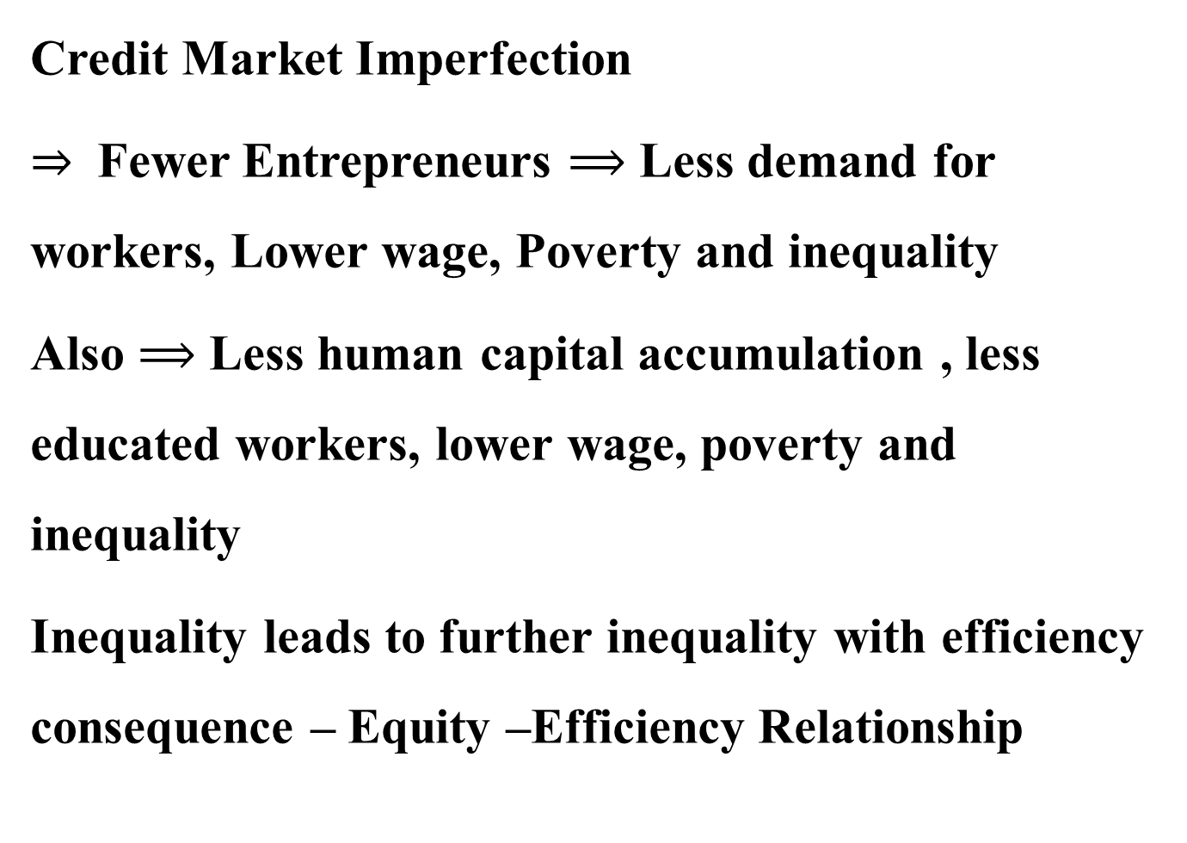
Credit Market Imperfection
$⇒$ Fewer Entrepreneurs $⟹$ Less demand for workers, Lower wage, Poverty and inequality
Also $⟹$ Less human capital accumulation , less educated workers, lower wage, poverty and inequality
Inequality leads to further inequality with efficiency consequence – Equity –Efficiency Relationship

Slide 13
Does Initial Asset Distribution necessarily affect production in the credit intensive sector by affecting access to credit?
Implications for International Trade and Inequality.
Its more than inequality, product market imperfection matters

