Slide 1

Economic Growth Under Ideal and Non-Ideal Conditions
$Y_{t}=AK_{t}^{α}$ $0<α<1$ … (1.1)
$g_{y}=\frac{Y_{t+1}−Y_{t}}{Y_{t}}=\frac{AK_{t+1}^{α}−AK_{t}^{α}}{AK_{t}^{α}}$
$=\frac{AK_{t}^{α}g_{t}^{α}−AK_{t}^{α}}{AK_{t}^{α}}$
$=g_{t}^{α}−1$ … (2.1) , $g_{t}>1$
$→$ Growth rate of capital stock.

Slide 2
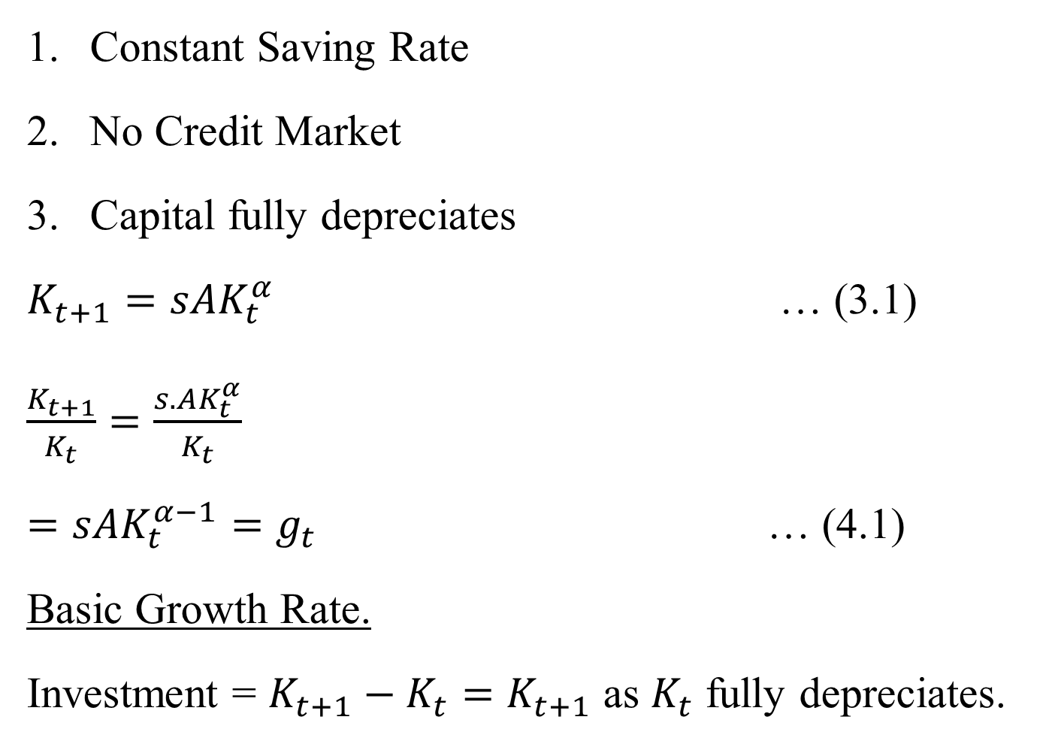
Constant Saving Rate
No Credit Market
Capital fully depreciates
$K_{t+1}=sAK_{t}^{α}$ … (3.1)
$\frac{K_{t+1}}{K_{t}}=\frac{s.AK_{t}^{α}}{K_{t}}$
$=sAK_{t}^{α−1}=g_{t}$ … (4.1)
Basic Growth Rate.
Investment = $K_{t+1}−K_{t}=K_{t+1}$ as $K_{t}$ fully depreciates.

Slide 3


Note $g_{t}↑$ if s and A increase
Also $g_{t}↓$ as $K_{t}↑$ given $s, A$
Hence $g_{y}↓$ as $K_{t}↑$
$$K_{t+1}$$
$$K_{t+1}=∅\left(K_{t}\right)$$
$${45}^{0}$$
$$K_{0}$$
$$K_{1}$$
Fig. 1.1

Slide 4
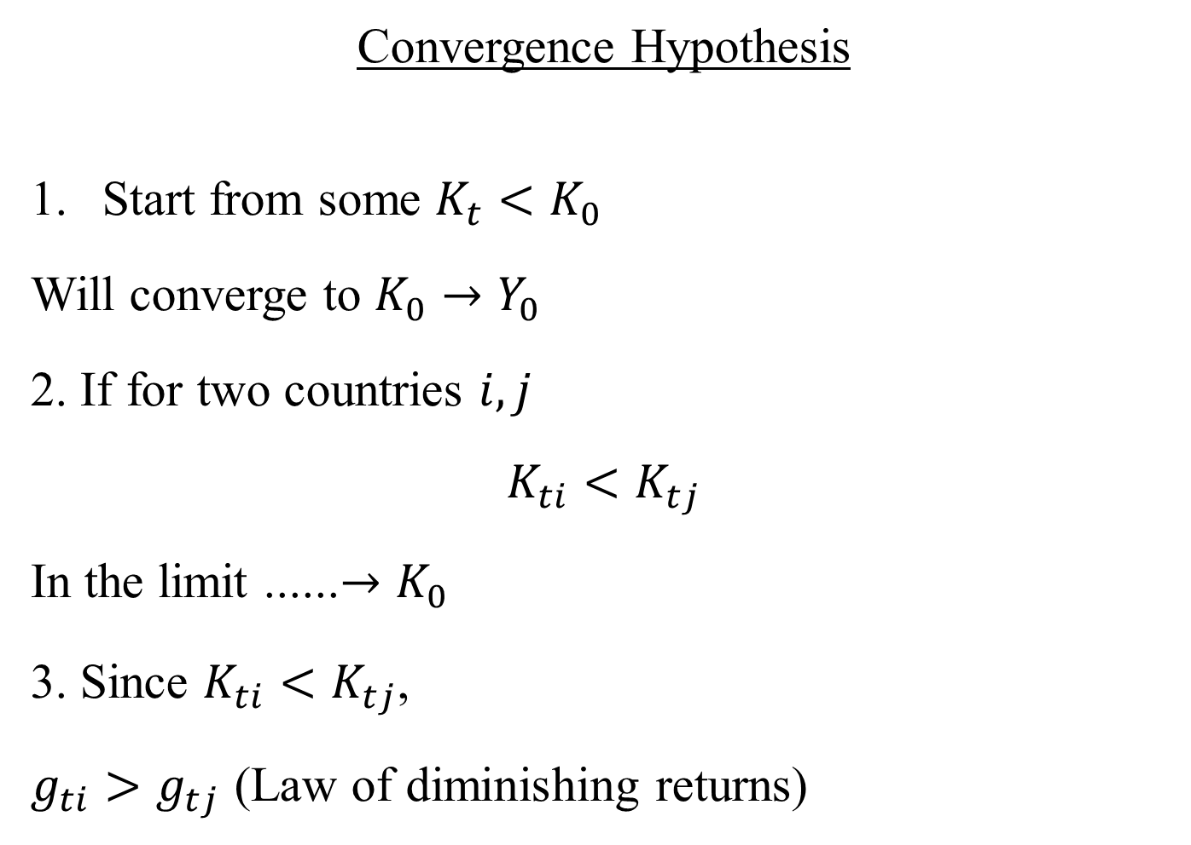
Convergence Hypothesis
Start from some $K_{t}<K_{0}$
Will converge to $K_{0}→Y_{0}$
2. If for two countries $i, j$
$$K_{ti}<K_{tj}$$
In the limit ......$→K_{0}$
3. Since $K_{ti}<K_{tj}$,
$g_{ti}>g_{tj}$ (Law of diminishing returns)

Slide 5
4. Will poor countries grow faster ?
This is also the prediction of standard Solow type growth model. Off Steady state Behavior
$$n$$
$$sf(k)$$
$$k$$
Fig-1.2
$n→$ Population growth rate, $k=K/L$

Slide 6
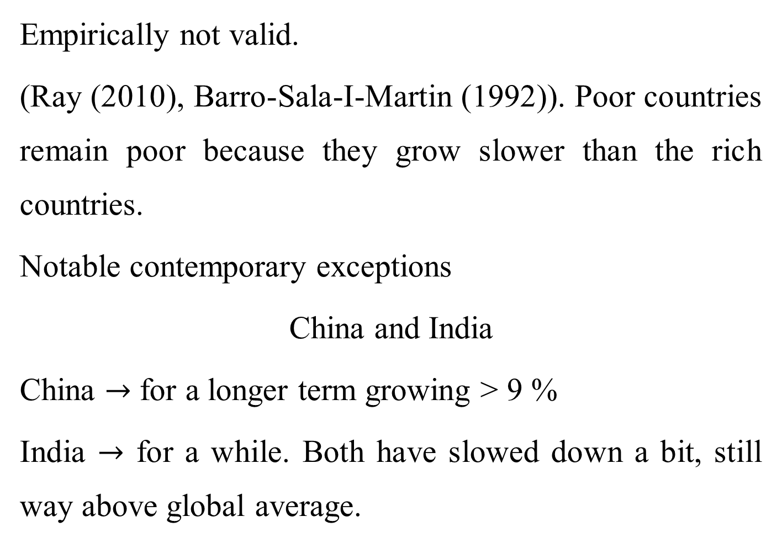
Empirically not valid.
(Ray (2010), Barro-Sala-I-Martin (1992)). Poor countries remain poor because they grow slower than the rich countries.
Notable contemporary exceptions
China and India
China $→$ for a longer term growing > 9 %
India $→$ for a while. Both have slowed down a bit, still way above global average.

Slide 7
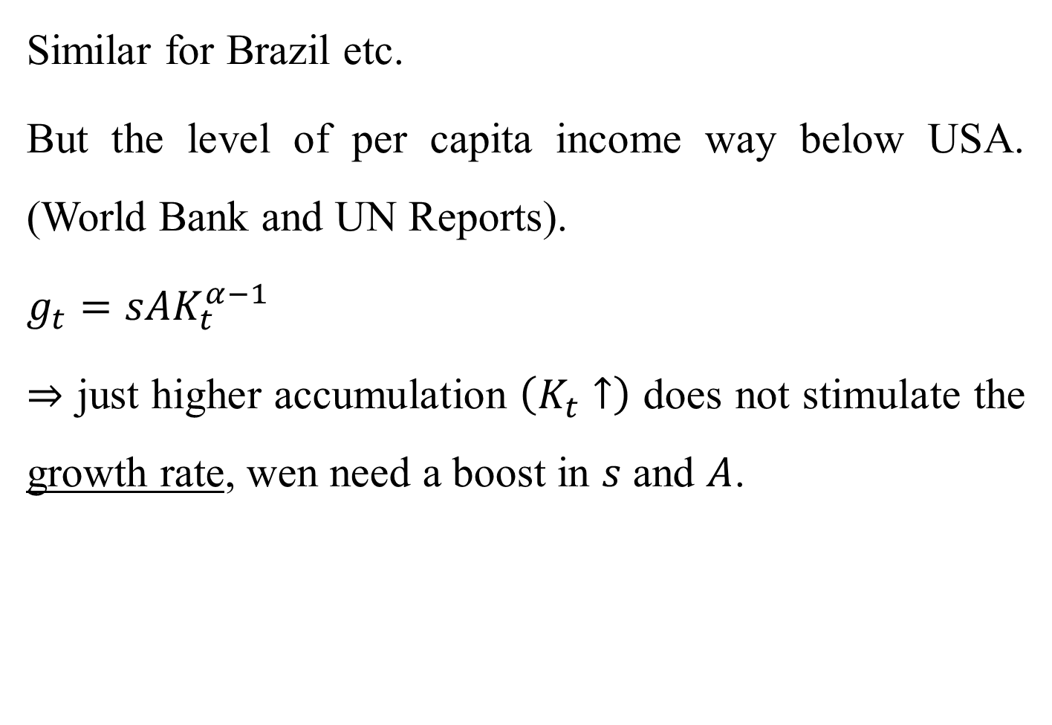
Similar for Brazil etc.
But the level of per capita income way below USA. (World Bank and UN Reports).
$g_{t}=sAK_{t}^{α−1}$
$⇒$ just higher accumulation $\left(K_{t}↑\right)$ does not stimulate the growth rate, wen need a boost in $s$ and $A$.

Slide 8
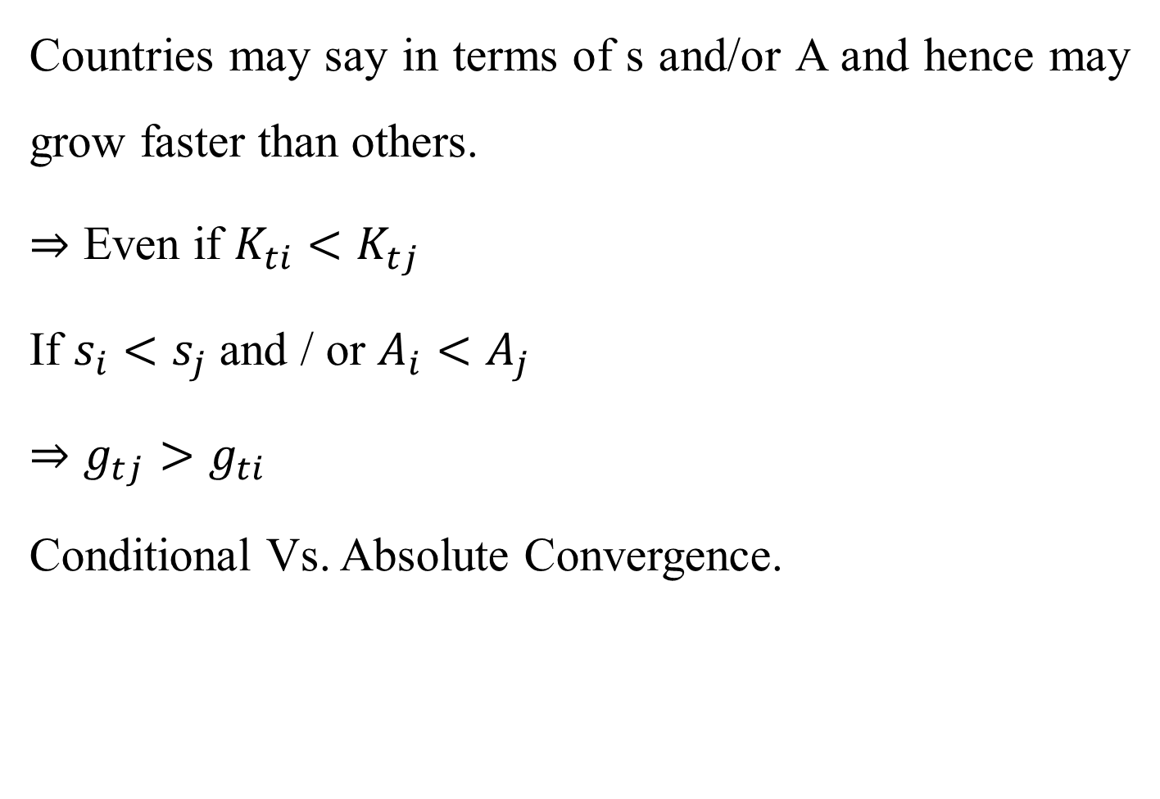
Countries may say in terms of s and/or A and hence may grow faster than others.
$⇒$ Even if $K_{ti}<K_{tj}$
If $s_{i}<s_{j}$ and / or $A_{i}<A_{j}$
$⇒$ $g_{tj}>g_{ti}$
Conditional Vs. Absolute Convergence.

Slide 9
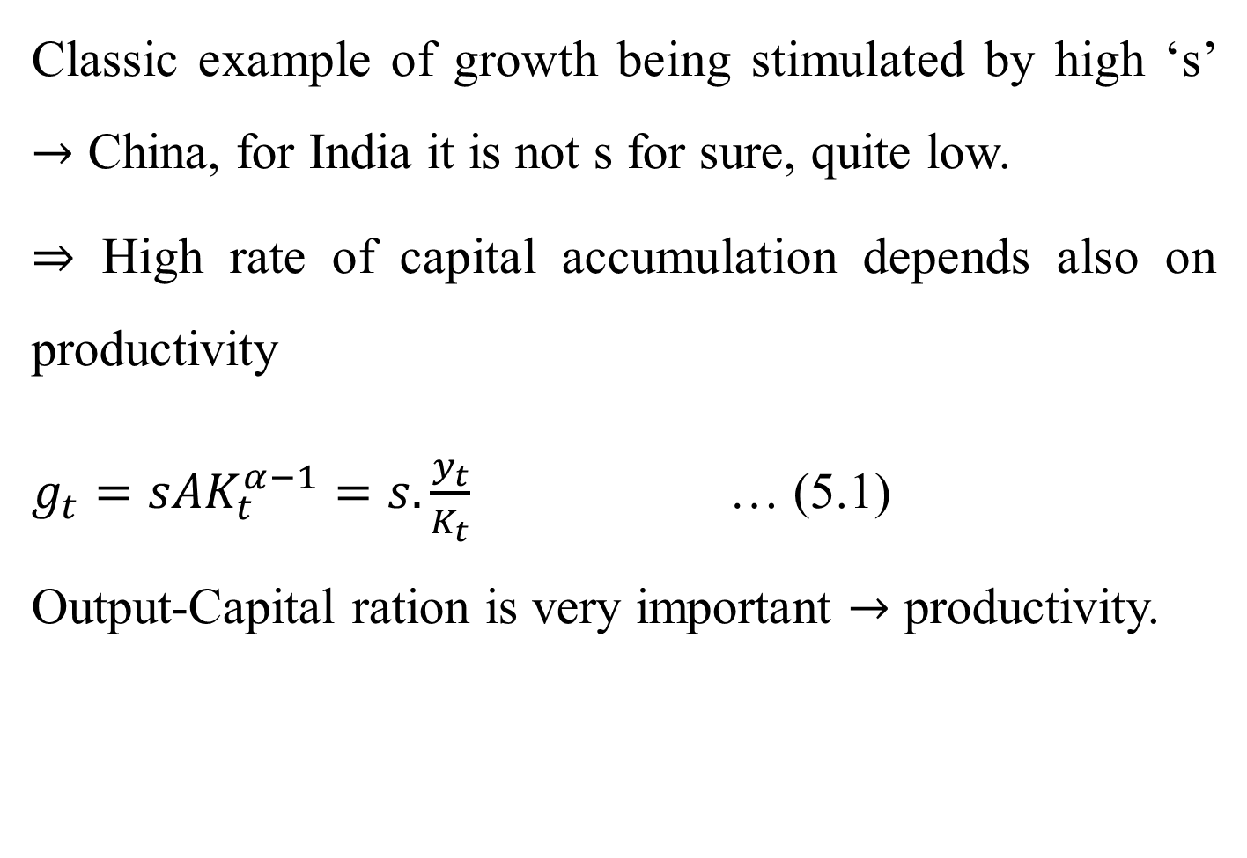
Classic example of growth being stimulated by high ‘s’ $→$ China, for India it is not s for sure, quite low.
$⇒$ High rate of capital accumulation depends also on productivity
$g_{t}=sAK_{t}^{α−1}=s.\frac{y_{t}}{K_{t}}$ … (5.1)
Output-Capital ration is very important $→$ productivity.

Slide 10
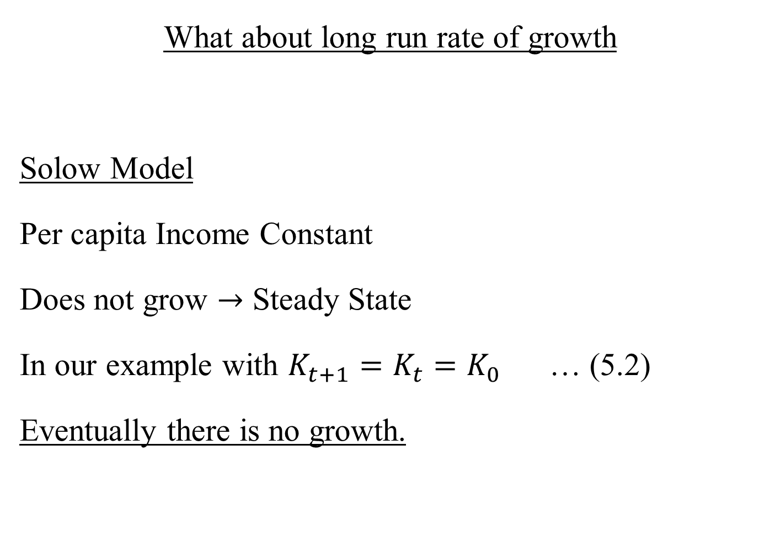
What about long run rate of growth
Solow Model
Per capita Income Constant
Does not grow $→$ Steady State
In our example with $K_{t+1}=K_{t}=K_{0}$ … (5.2)
Eventually there is no growth.

Slide 11
$$B_{2}$$
$$B_{1}$$
$${45}^{0}$$
$$k$$
$$k_{1}$$
$B_{1}→$ Higher s and / or A
Off steady state growth rate is higher say at $k_{1}$ and steady state $k$ is higher but no growth in the long run.

Slide 12
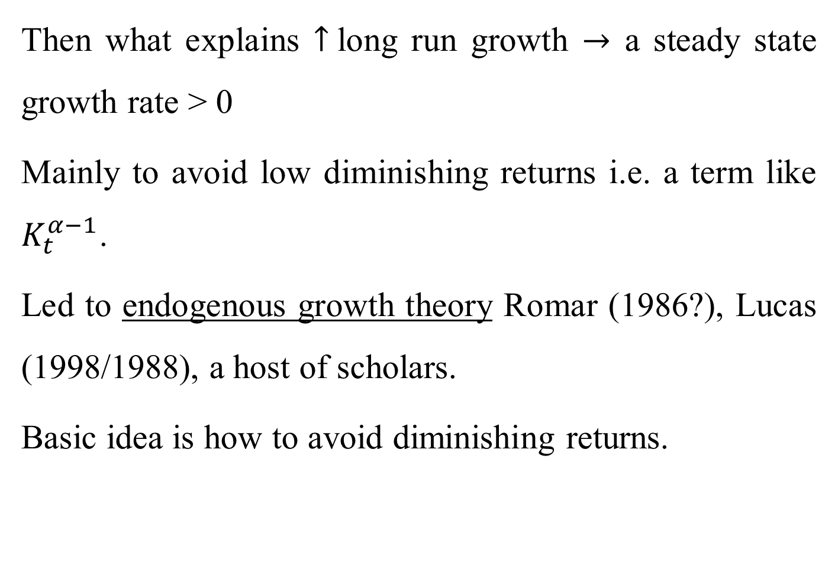
Then what explains $↑$long run growth $→$ a steady state growth rate > 0
Mainly to avoid low diminishing returns i.e. a term like $K_{t}^{α−1}$.
Led to endogenous growth theory Romar (1986?), Lucas (1998/1988), a host of scholars.
Basic idea is how to avoid diminishing returns.

Slide 13
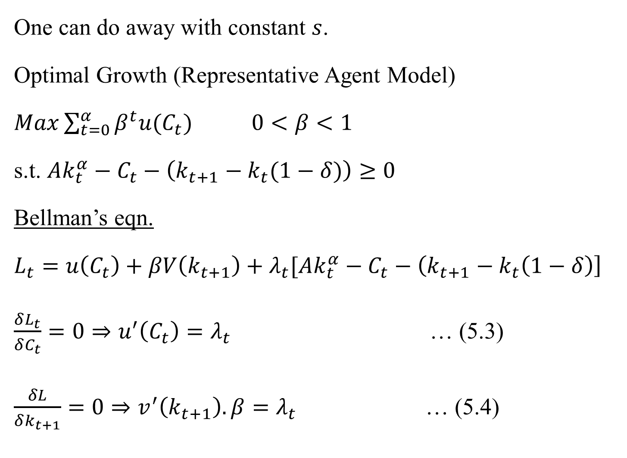
One can do away with constant $s$.
Optimal Growth (Representative Agent Model)
$Max\sum_{t=0}^{α}{β^{t}u(C_{t})}$ $0<β<1$
s.t. $Ak_{t}^{α}−C_{t}−\left(k_{t+1}−k_{t}(1−δ)\right)≥0$
Bellman’s eqn.
$L_{t}=u\left(C_{t}\right)+βV\left(k_{t+1}\right)+λ_{t}[Ak_{t}^{α}−C_{t}−\left(k_{t+1}−k_{t}\left(1−δ\right)\right]$
$\frac{δL_{t}}{δC_{t}}=0⇒u^{′}\left(C_{t}\right)=λ_{t}$ … (5.3)
$\frac{δL}{δk_{t+1}}=0⇒v^{′}\left(k_{t+1}\right).β=λ_{t}$ … (5.4)

Slide 14
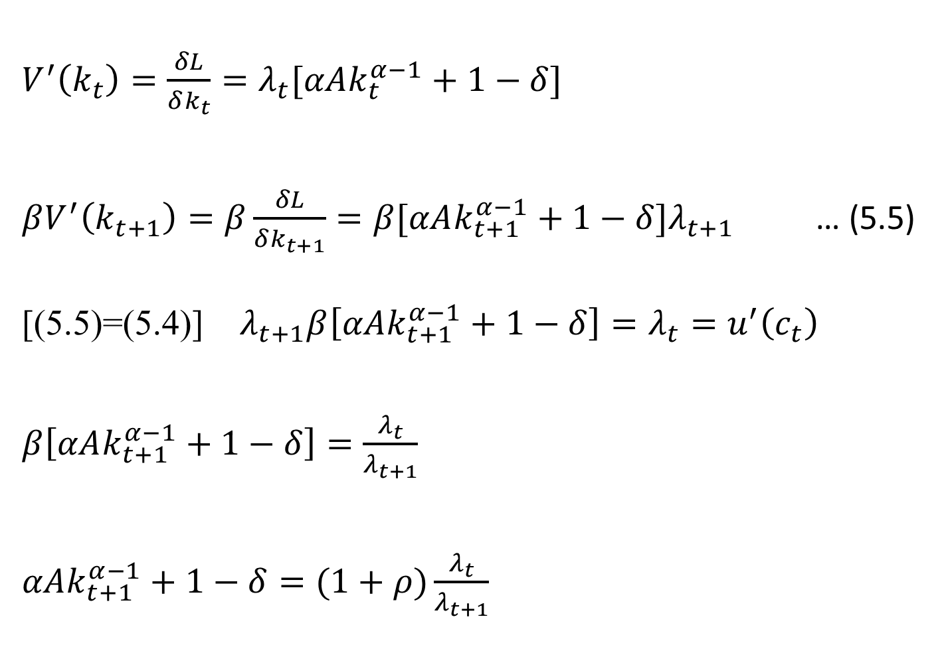
$V^{′}\left(k_{t}\right)=\frac{δL}{δk_{t}}=λ_{t}[αAk_{t}^{α−1}+1−δ]$
$βV^{′}\left(k_{t+1}\right)=β\frac{δL}{δk_{t+1}}=β[αAk_{t+1}^{α−1}+1−δ]λ_{t+1}$ … (5.5)
[(5.5)=(5.4)] $λ_{t+1}β\left[αAk_{t+1}^{α−1}+1−δ\right]=λ_{t}=u^{′}\left(c_{t}\right)$
$β\left[αAk_{t+1}^{α−1}+1−δ\right]=\frac{λ_{t}}{λ_{t+1}}$
$αAk_{t+1}^{α−1}+1−δ=(1+ρ)\frac{λ_{t}}{λ_{t+1}}$

Slide 15

$\frac{λ_{t}}{λ_{t+1}}=[MPK_{t+1}+1−δ]\frac{1}{1+ρ}$
Let $u\left(c_{t}\right)=lnc_{t}$
Then $\frac{λ_{t}}{λ_{t+1}}=\frac{c_{t+1}}{c_{t}}$
$\frac{c_{t+1}−c_{t}}{c_{t}}=\frac{MPK_{t+1}+1−δ−1−ρ}{1+ρ}$
$g_{ct}=\frac{MPK_{t+1}−(ρ+δ)}{1+ρ}$
Again $g_{ct} ↓$ over time as $MPK_{t+1} ↓$
$g_{ct}=0$ when ($MPK=ρ+δ)$
(Modified Golden Rule)

