Slide 1
Lecture – 4
Behavioral Complexities
Status Factor

Slide 2
Major Motivation
Whether concern for relative status by the poor through their perception of social inequality affects poverty and measures of poverty.
Model Theoretically such behavior in static and dynamic contexts.
Simple and pertinent modeling can show that
Status effect explains the conflict between income and nutrition based measures.
Growth with malnutrition.

Slide 3
Indian Literature
Pattnaik (2007), Deaton and Drèze (2009), Economic Survey (2011),
Radhakrishna and Ravi (2004), Griffiths (2001), Svedberg (2008)
First two papers on measures
Economic survey (2011) Growth Problem
Last three papers on Nutrition Aspect But status effect is not highlighted.

Slide 4
Whether status effect is quantitatively strong must be assessed first to underscore the effect of inequality on poverty. This paper bridges that gap.
Growth Inequality Consumption and investment effects in different consumption classes including the poor growth and nutritional inequality and poverty.

Slide 5
Global Literature
Veblen’s idea of demonstration effect Frank (1985), Sivanathan and Pettit (2010), Mujcic and Frijters (2013) Reflections on Behavioral pattern.
Status and growth Cole et al (1992), Corneo and Jean (2001). This is signaling effect. Ours is different. This comes from social-psychological factors , grounded in Experimental Psychology.
Status, Welfare and Optimal Taxation – Kanbur and Tuomala (2010), Beath and Fitzroy (2010).

Slide 6
Status, Poverty Trap and Risk Behaviour
Moav and Neeman (2012), Robson (1992), Robson and Ray (2012), etc.
Theoretical work so far has not looked at how status effect can impact on nutritional measures of poverty and how concern for social status may improve growth but at the same time may encourage malnutrition. Also how to represent the idea in a clean and simple mathematical structure.

Slide 7
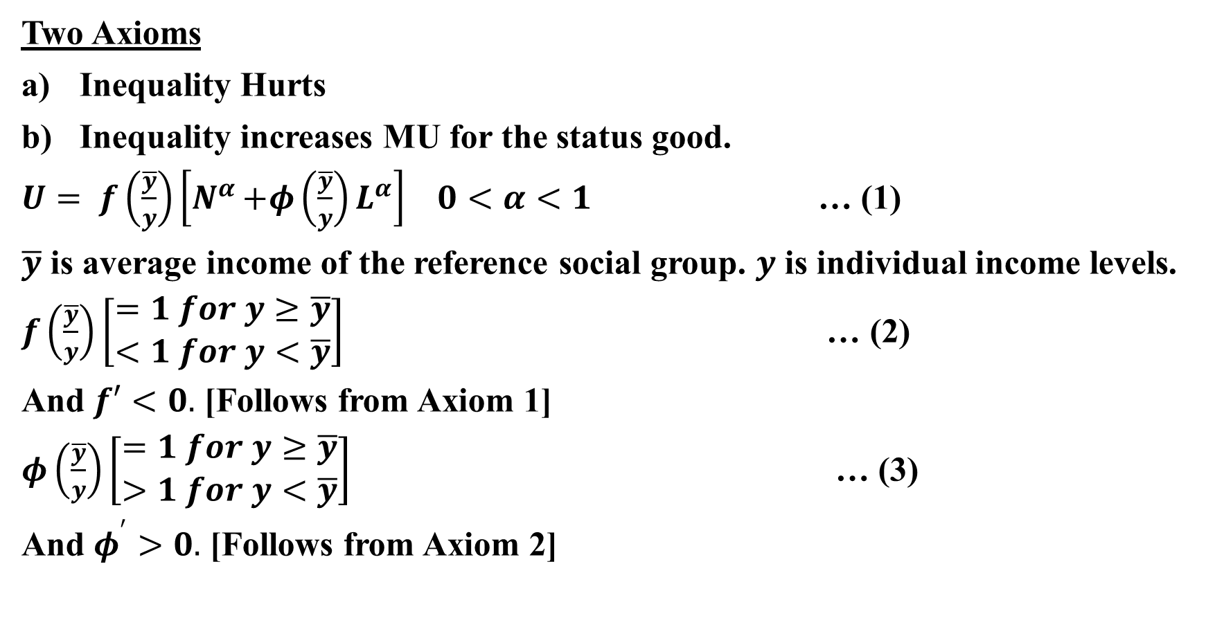
Static Model

Slide 8
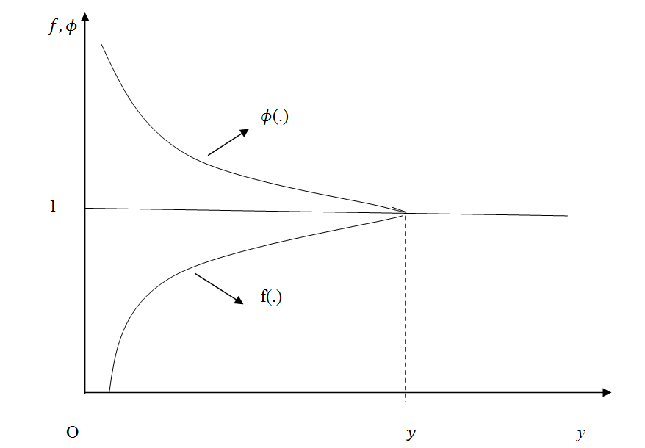
Figure - 1

Slide 9
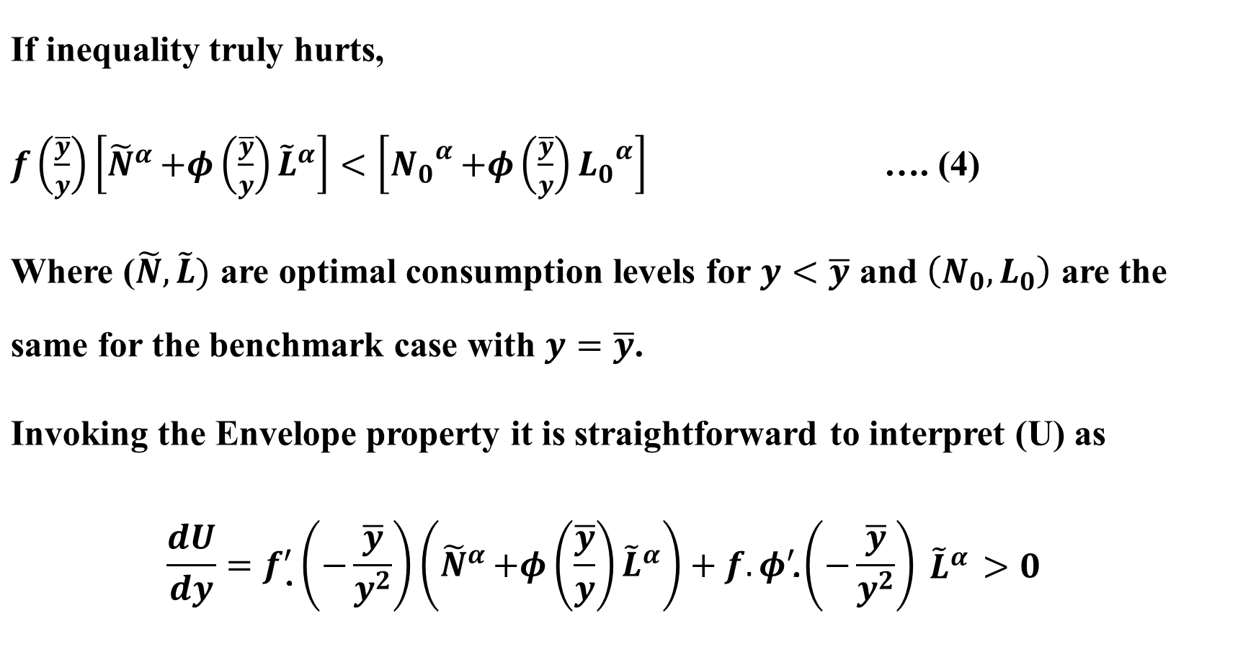

Slide 10
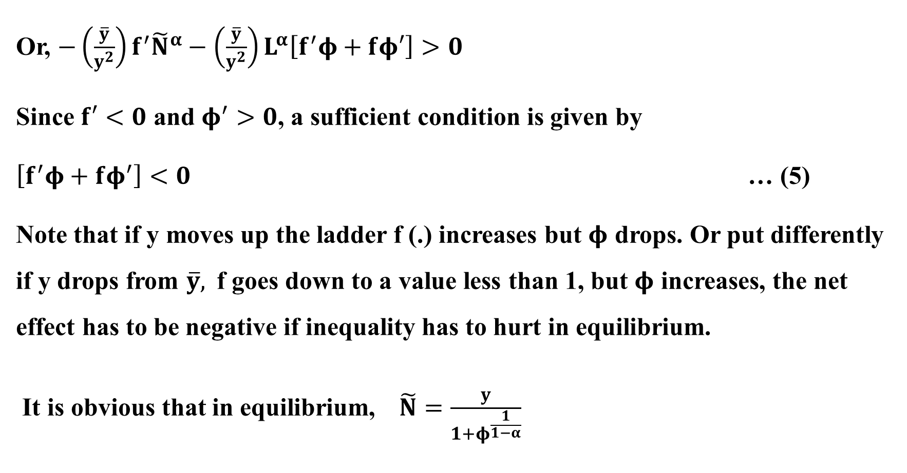

Slide 11
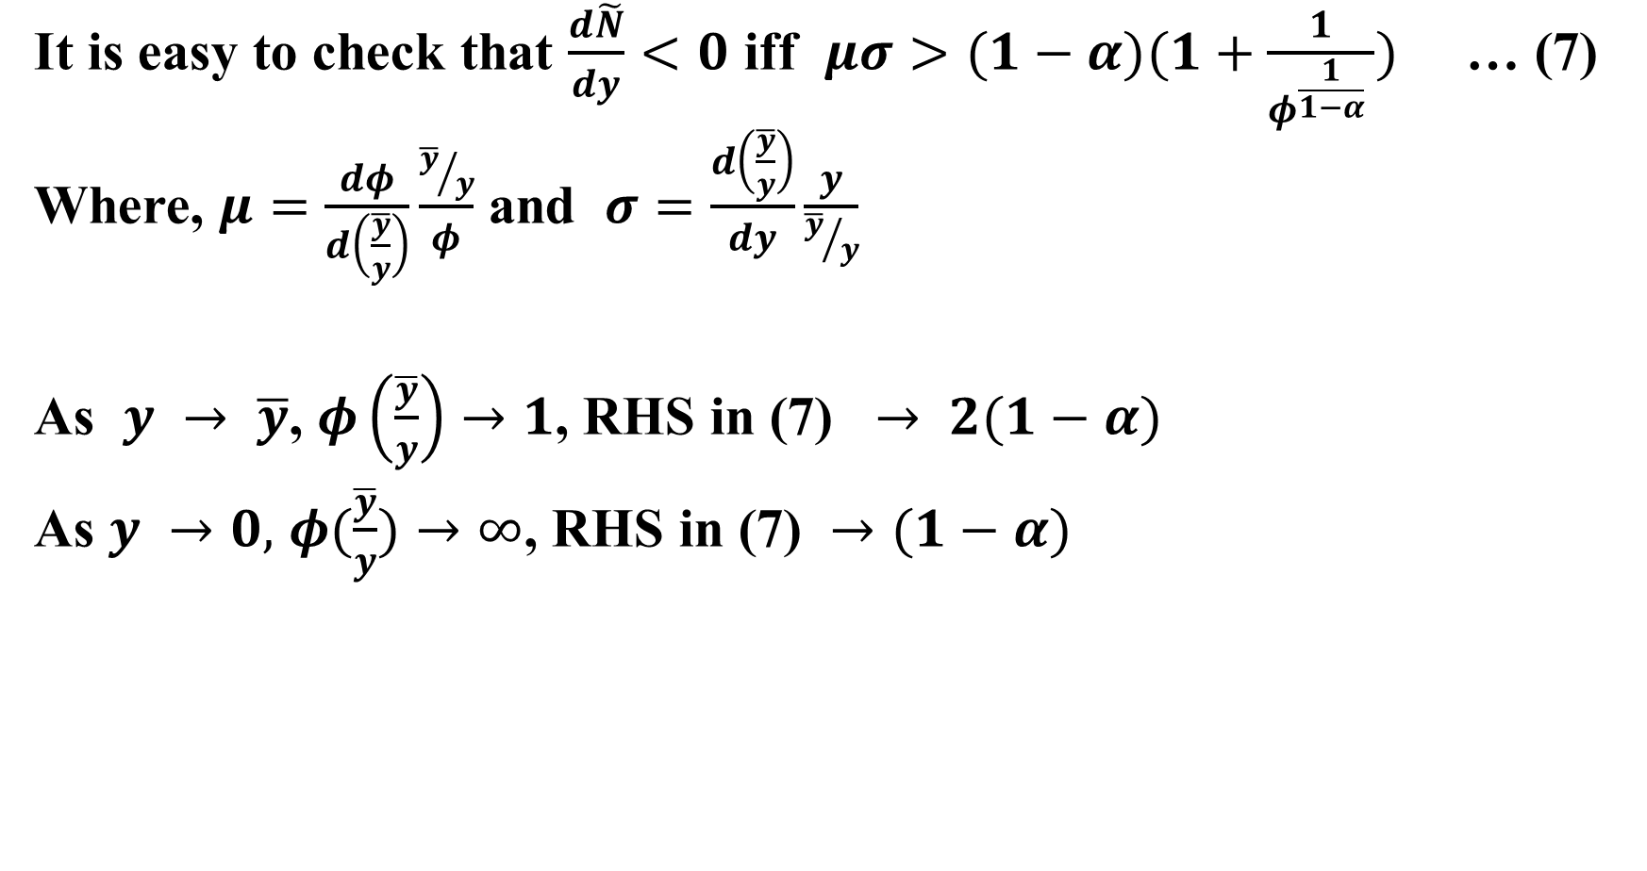

Slide 12

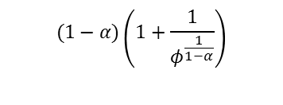



O
1
Figure - 2

Slide 13
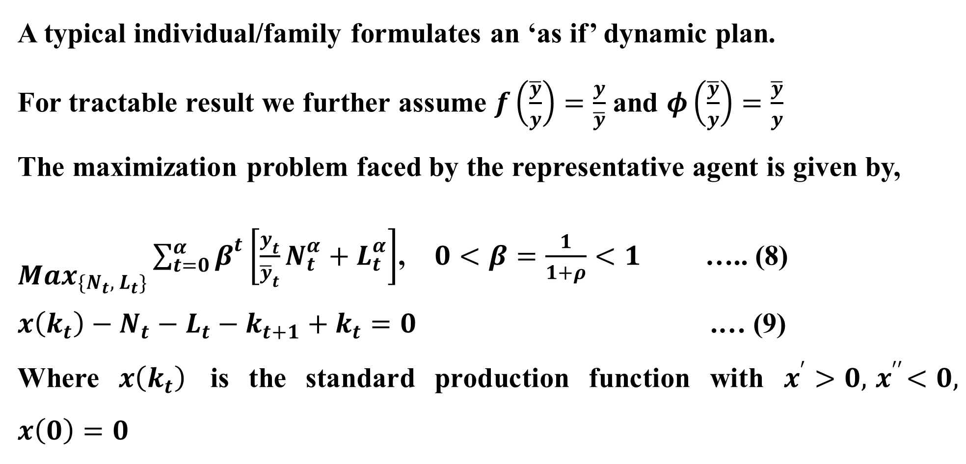
Dynamic Model – Growth with Malnutrition

Slide 14
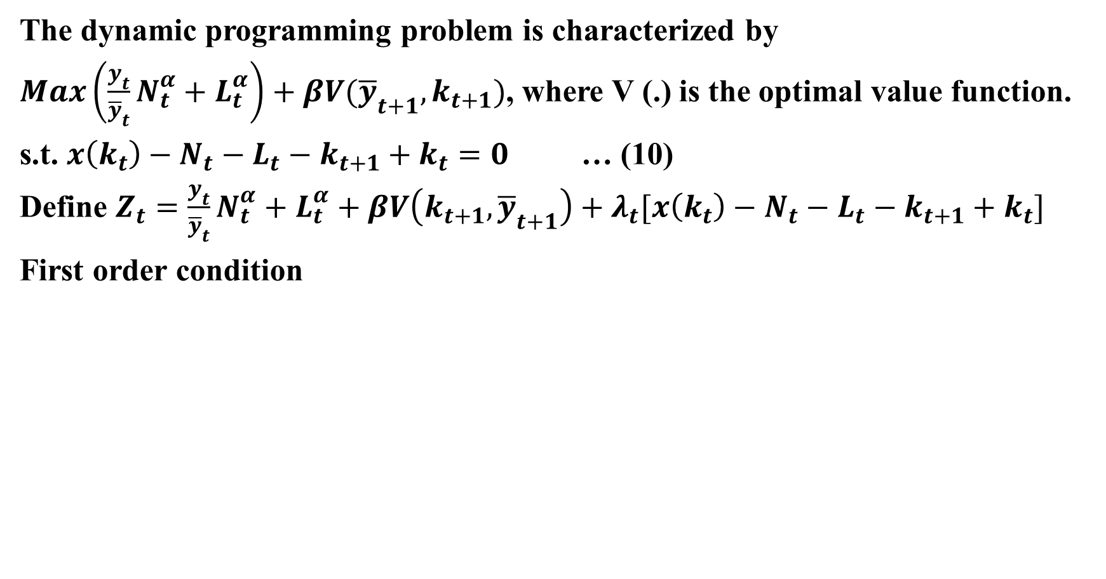

Slide 15
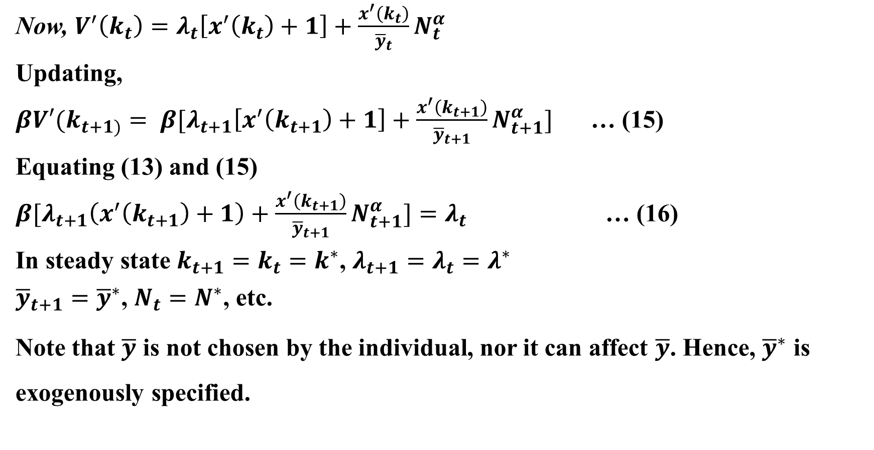

Slide 16
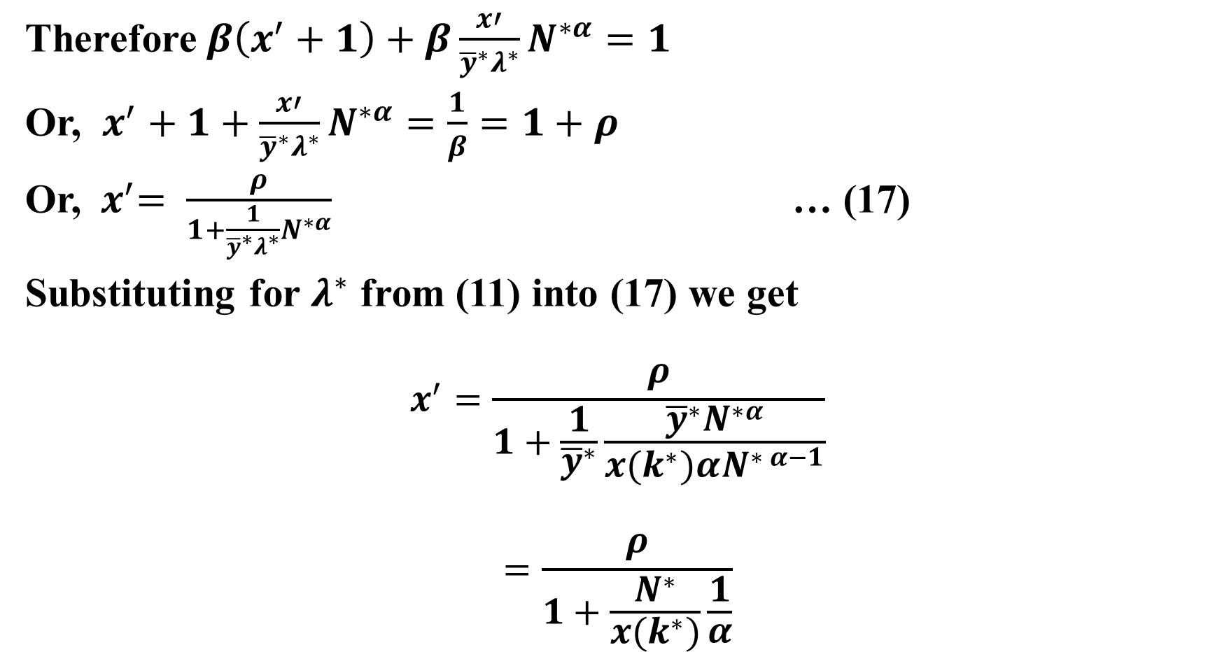

Slide 17
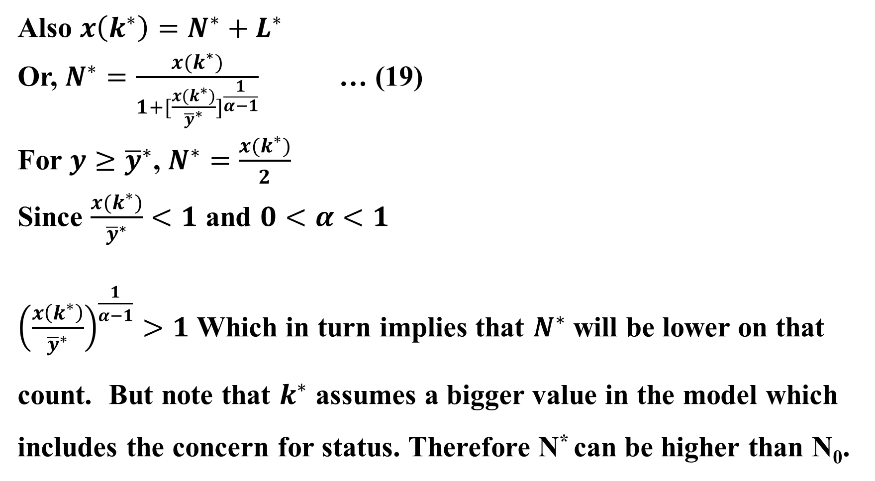

Slide 18
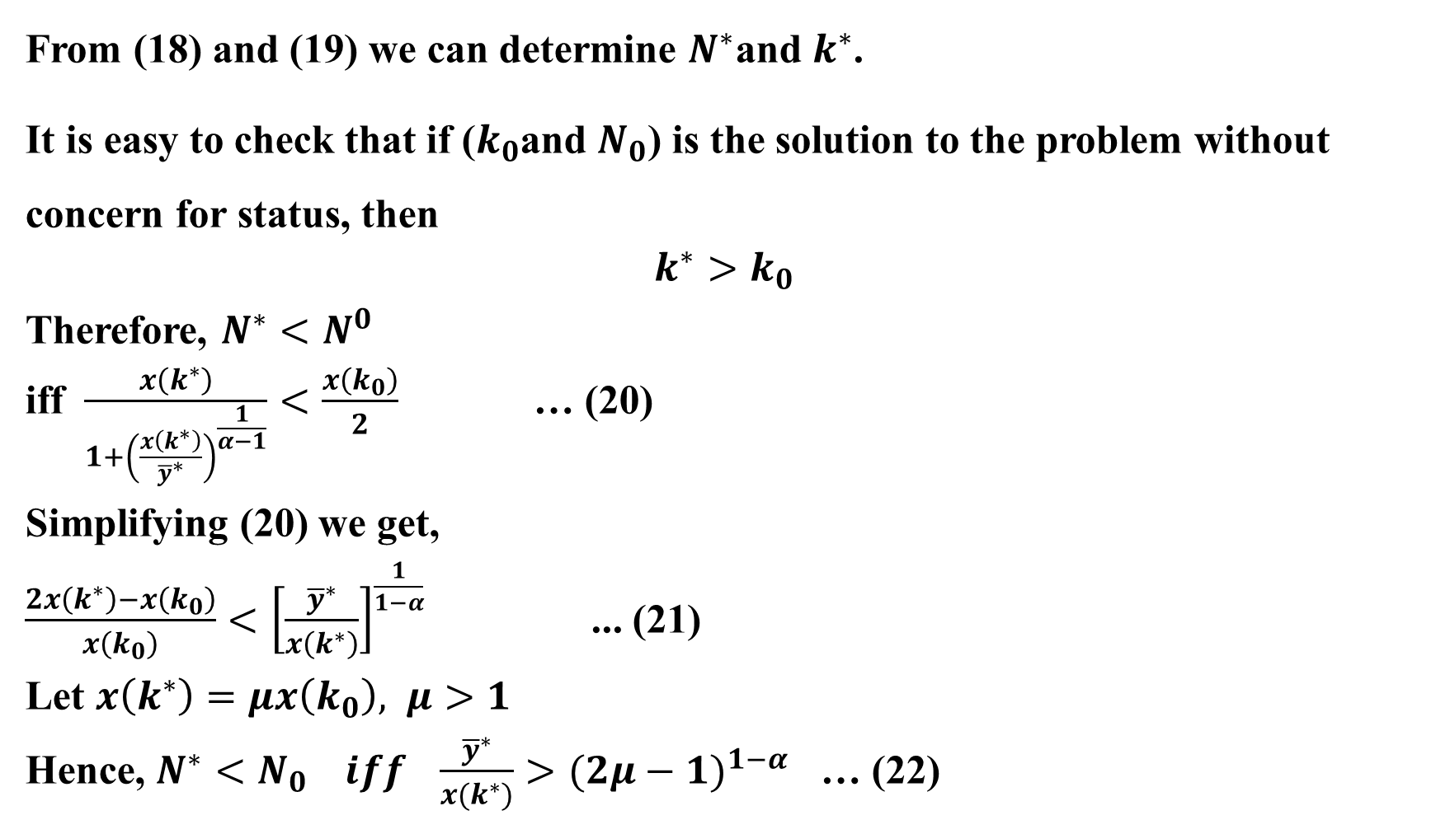

Slide 19
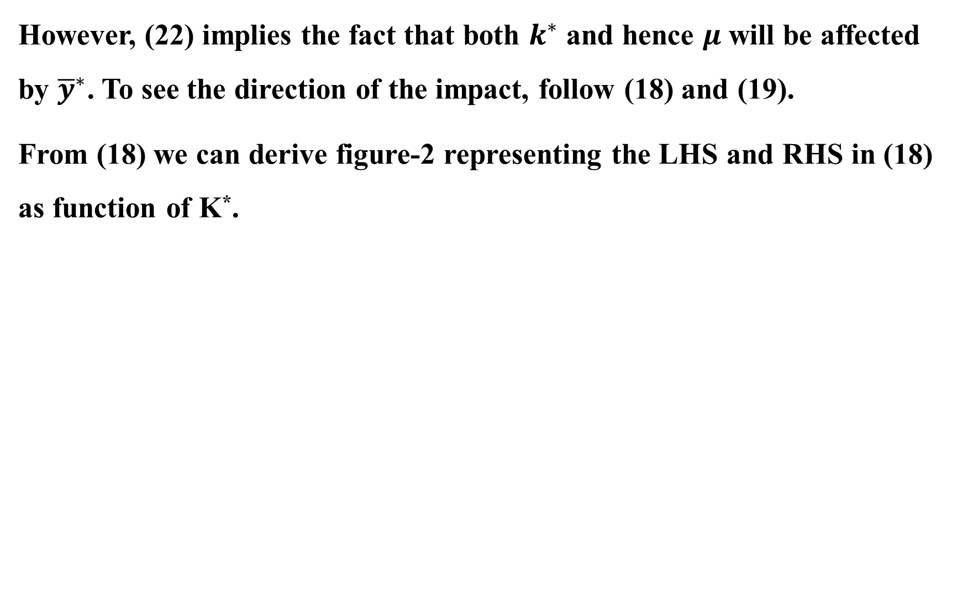
RHS (18), LHS (18)
RHS (18)
LHS (18)
Figure 3
k*

Slide 20
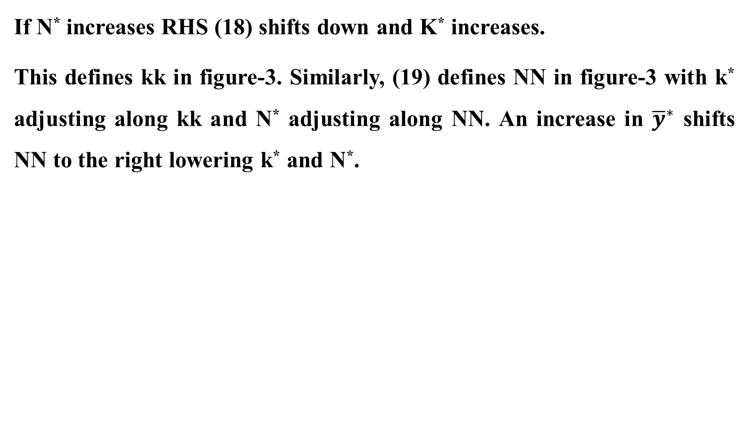
N*
k
N
N
k
Figure 4
k*

Slide 21
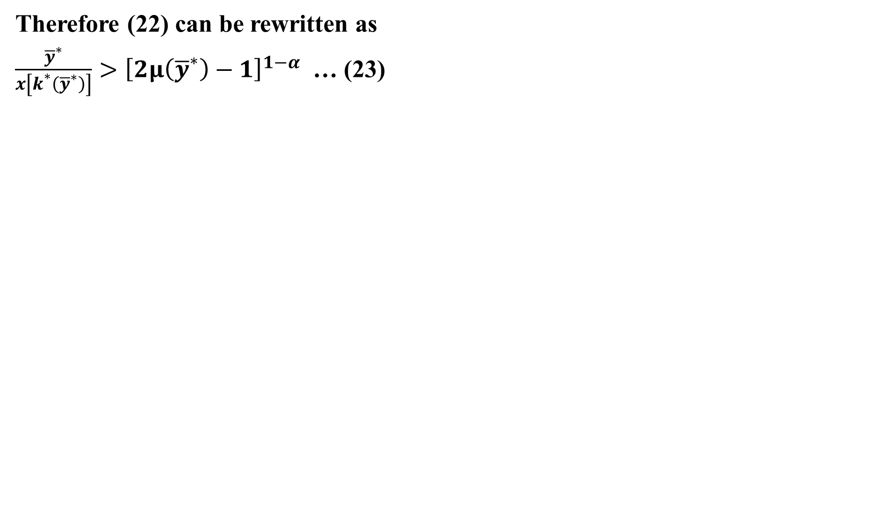

LHS (23)
RHS (23)
Figure 5

Slide 22
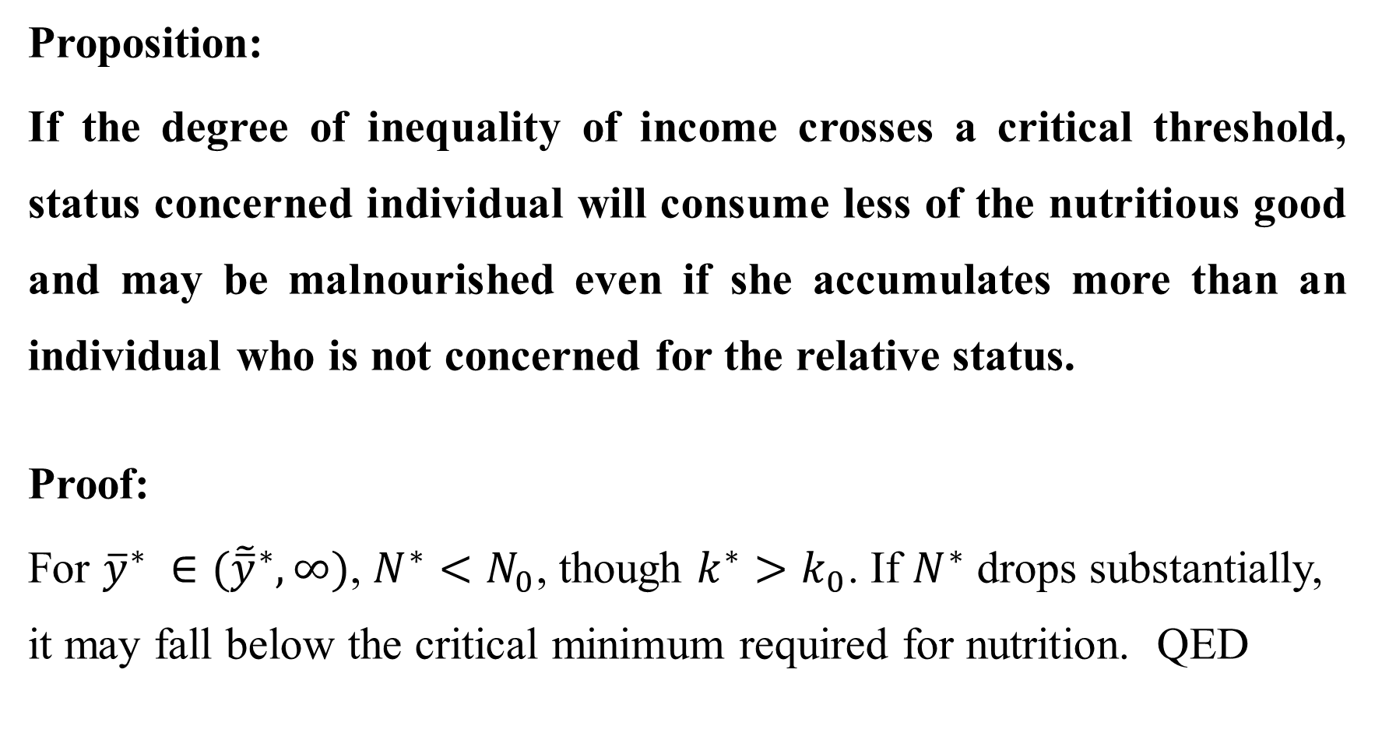

Slide 23
