Slide 1
Lecture – 6 Political Economy Perspective

Slide 2
Major Issues
How politics affects growth and development process – Global and Local
Policies and Institutions in Democracy
Inequality and Growth ( Ostry and Berg IMF, 2014) , Inequality and Fiscal Policy (IMF,2016)
Rent Seeking and Regulatory Reform
Corruption, Growth and Reform

Slide 3
Standard Perspectives
Taxation can affect economic growth, a straightforward application of Optimum Growth Model. Higher tax rate implies lower rate of growth.
More interesting issues- Inequality and Growth.

Slide 4
Why Inequality can affect Growth
Median Voter may vote for a capital income tax policy in a society where asset distribution is skewed. ( Persson /Tabelini/Alesina/Rodrik).
That again is difficult to sustain universally – China and India – Why they are fastest growing nations - Political System is entirely different.

Slide 5
China and India
Dictatorship vs Democracy leading to different pattern of Growth. Institutional Difference leading to industrial growth in China and Service led growth in India.
The Land Conversion Problem and Human Displacement. Marjit and Kar (2017 )
Infrastructural Investment vs. Knowledge Economy and ICT revolution.

Slide 6
Democratic Politics and Development
Complex Issues
Corruption, Growth , Rent Seeking
Congleton and Hillman (2015) volume on Rent Seeking , Resource Allocation and Development – Theory and Empirics, Various Essays such as Marjit and Mukherjee (2015)
Corruption and Growth – Cross Country Evidence ( Mauro (1995) again has major exceptions Why?

Slide 7
Corruption can help growth ,but may hurt development process
Some corruption is strategic – Why so much Informal activities in LDCs ? Shadow activities, Extra legal arrangements-supposed to be bad for growth – Hernando De Soto ‘s famous book, Mystery of Capital,2000).
But informality , at least a part of it is a political strategy ,its endogenous –Marjit, Mukherjee and Kolmer (2006)

Slide 8
New Perspectives on
Corruption, Growth and Trade
Marjit and Mandal (2012 ), Marjit, Mandal and Roy ( 2014 ) etc.
How corruption affects pattern of trade for a labor abundant country by cutting back volume of trade as corrupt activities are labor intensive.

Slide 9
Rent-Seeking and Reform: Traditional View
Reforms that reduce the amount of rent available (like introduction of product market competition/trade liberalization) reduces wasteful expenditures in rent-seeking (like bribery)

Slide 10
Corruption
0
Liberalization
← t

Slide 11
Ades and Di Tella (1999): American Economic Review
Corruption
0
Liberalization
← t

Slide 12
Motivation
It appears that after trade liberalization corruption has increased significantly in high growth economies like India and China
…………Can rent-seeking theory provide
an explanation?
…………..So we revisit the relation between
rent-seeking and reform

Slide 13
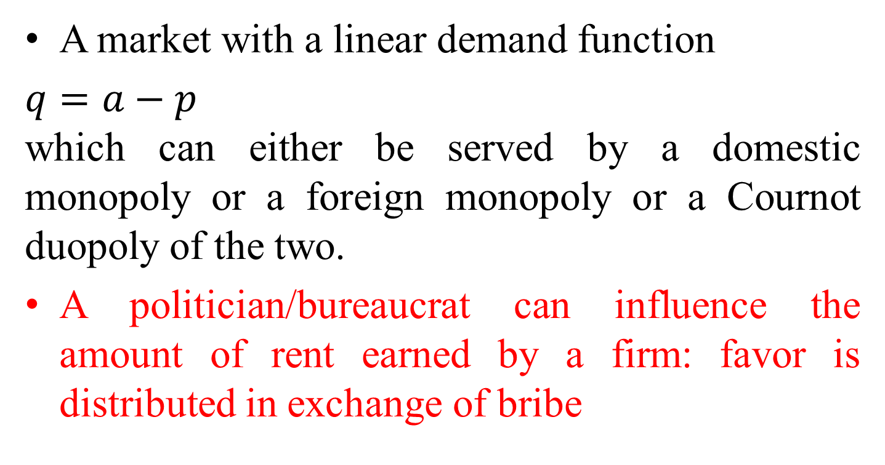
The Model
A market with a linear demand function
$q=a−p$
which can either be served by a domestic monopoly or a foreign monopoly or a Cournot duopoly of the two.
A politician/bureaucrat can influence the amount of rent earned by a firm: favor is distributed in exchange of bribe

Slide 14
0
t

Slide 15
the reform-implementing corrupt politician/bureaucrat chooses that rate of tariff/regulation which maximizes her rent
the firms involved in rent seeking competition are asymmetric: the foreign firm having cost advantage (mc = 0) over the domestic firm (mc > 0)
the society prefers a duopoly market structure rather than the monopoly either of a foreign firm or a domestic firm

Slide 16
0
t

Slide 17
Max π (t) by choosing t such that π_{f} > 0 and π_{d} > 0
π(t)
0
t
c < a/11

Slide 18
π(t)
0
t
c ∈ [a/11, a/2]

Slide 19
π(t)
0
t
a/2 < c < a

Slide 20
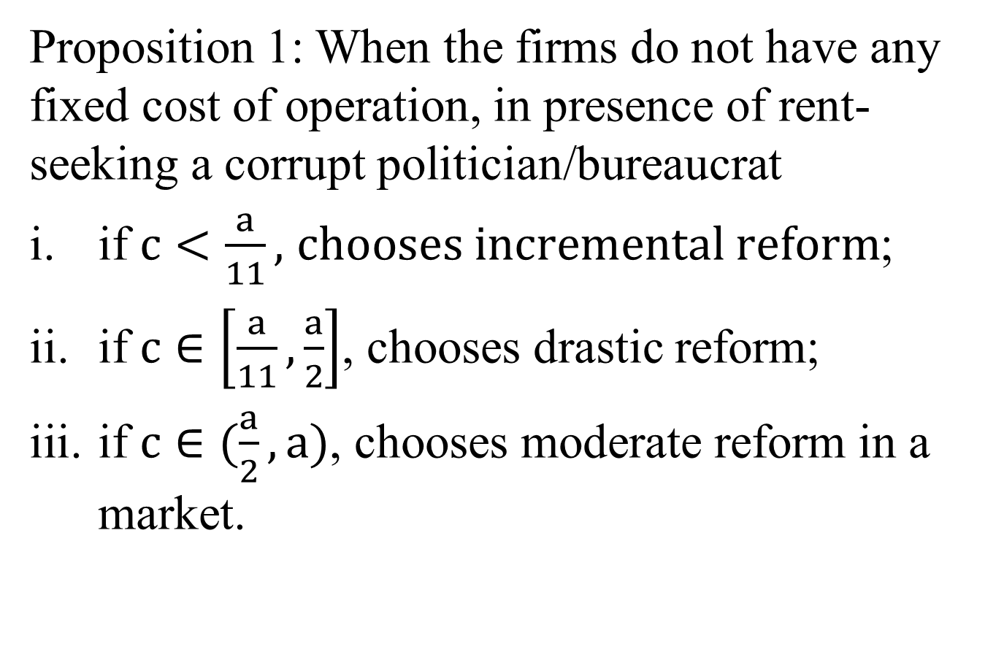
Proposition 1: When the firms do not have any fixed cost of operation, in presence of rent-seeking a corrupt politician/bureaucrat
if $c<\frac{a}{11},$ $chooses incremental reform$;
if $c∈\left[\frac{a}{11}, \frac{a}{2}\right]$, chooses drastic reform;
if $c∈(\frac{a}{2},a)$, chooses moderate reform in a market.

Slide 21
0
t

Slide 22
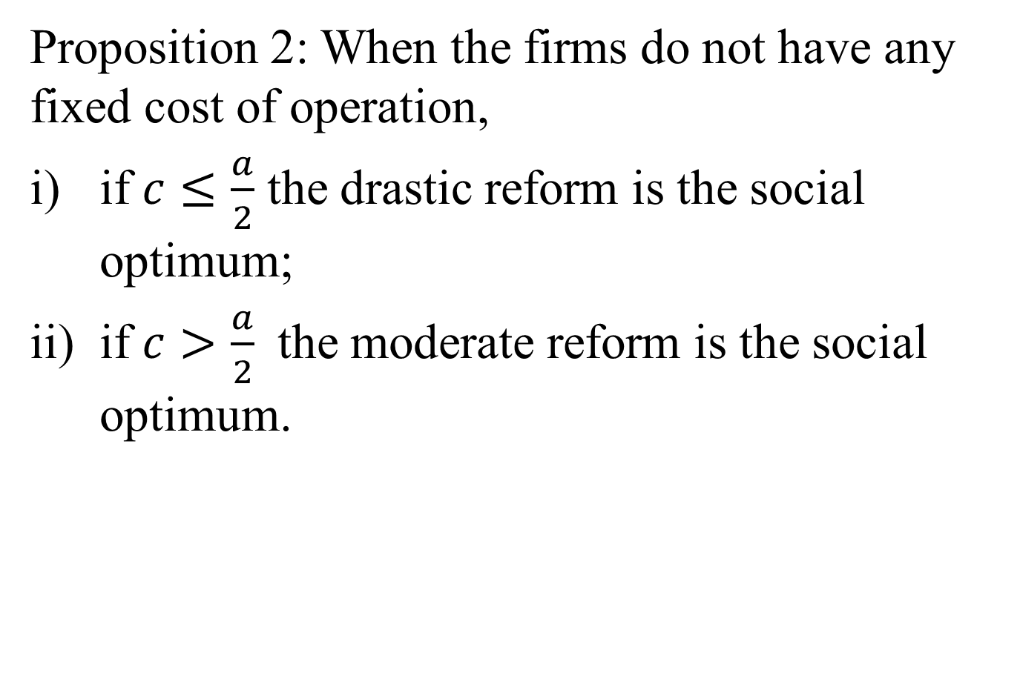
Proposition 2: When the firms do not have any fixed cost of operation,
if $c≤\frac{a}{2}$ the drastic reform is the social optimum;
if $c>\frac{a}{2}$ the moderate reform is the social optimum.

Slide 23
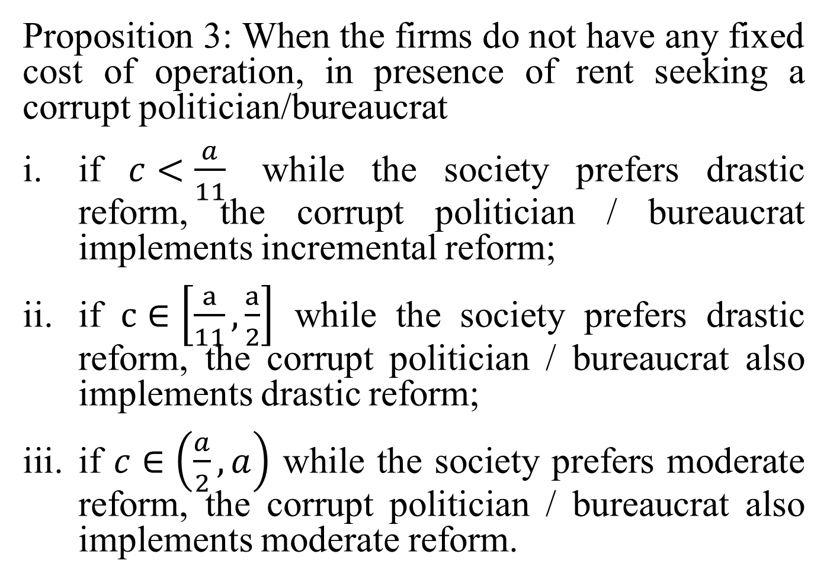
Proposition 3: When the firms do not have any fixed cost of operation, in presence of rent seeking a corrupt politician/bureaucrat
if $c<\frac{a}{11}$ while the society prefers drastic reform, the corrupt politician / bureaucrat implements incremental reform;
if $c∈\left[\frac{a}{11}, \frac{a}{2}\right]$ while the society prefers drastic reform, the corrupt politician / bureaucrat also implements drastic reform;
if $c∈\left(\frac{a}{2}, a\right)$ while the society prefers moderate reform, the corrupt politician / bureaucrat also implements moderate reform.

Slide 24
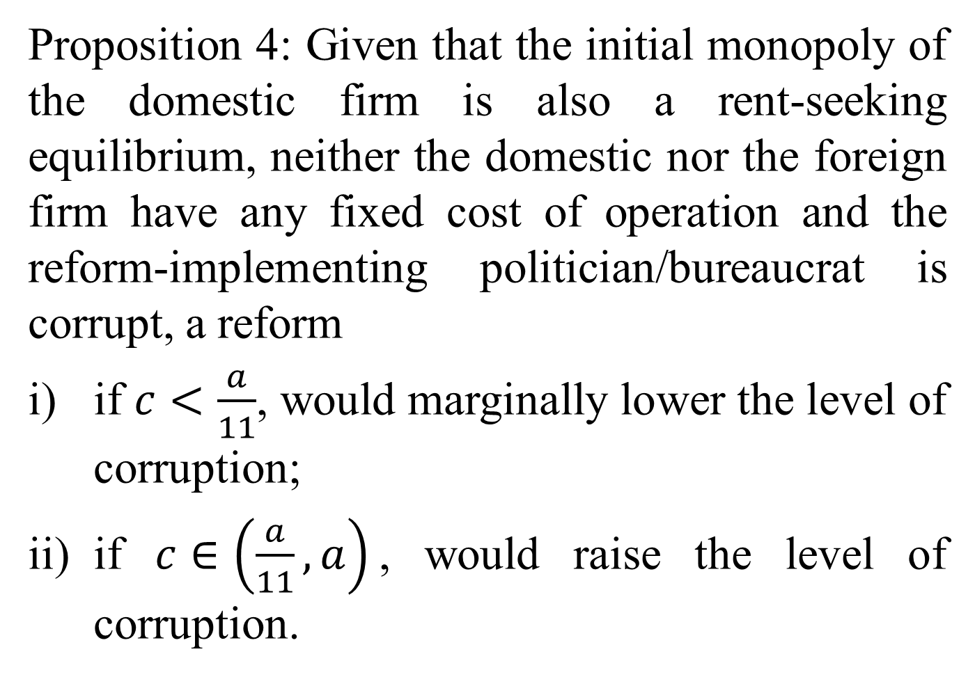
Proposition 4: Given that the initial monopoly of the domestic firm is also a rent-seeking equilibrium, neither the domestic nor the foreign firm have any fixed cost of operation and the reform-implementing politician/bureaucrat is corrupt, a reform
if $c<\frac{a}{11}$, would marginally lower the level of corruption;
if $c∈\left(\frac{a}{11},a\right)$, would raise the level of corruption.

Slide 25
There is a trade off between the efficiency and level of corruption in an economy
Technological advancement of the domestic firm plays an important role in explaining the type of reform adopted in an economy and the level of corruption realized in it.

Slide 26
Inequality and Conflict
The new political economy problems
BREXIT
Presidential Election in USA
Challenge to traditional right and left in France
Inequality across nations on the decline, within rising. Richer Nations have different perspective.

Slide 27
Inequality and Conflict
Global Problem –Falling Inequality between Nations, but Rising within Countries . Specially in the developed world. Alleged due to trade, outsourcing and immigration.
Ostry, Loungani and Furceri (2016) and Inequality and Fiscal Policy ( Gupta, Keen and Others) Both from the IMF.
It has led to significant political changes in Britain and USA. Protectionism follows.

Slide 28
Inequality and Conflict
Critical queries
Inequality has been rising everywhere, has it affected the politico-economic perspective in the developing world?
Why so much in the Developed World?
Is it because it’s the developing world contributing much more to world growth and there was no welfare state to start with or to be blamed there.

Slide 29
THANK YOU

